Slide 1


Wessex
Primary School
Year 3 Hazel & Holly
September 2026-2027

Slide 2
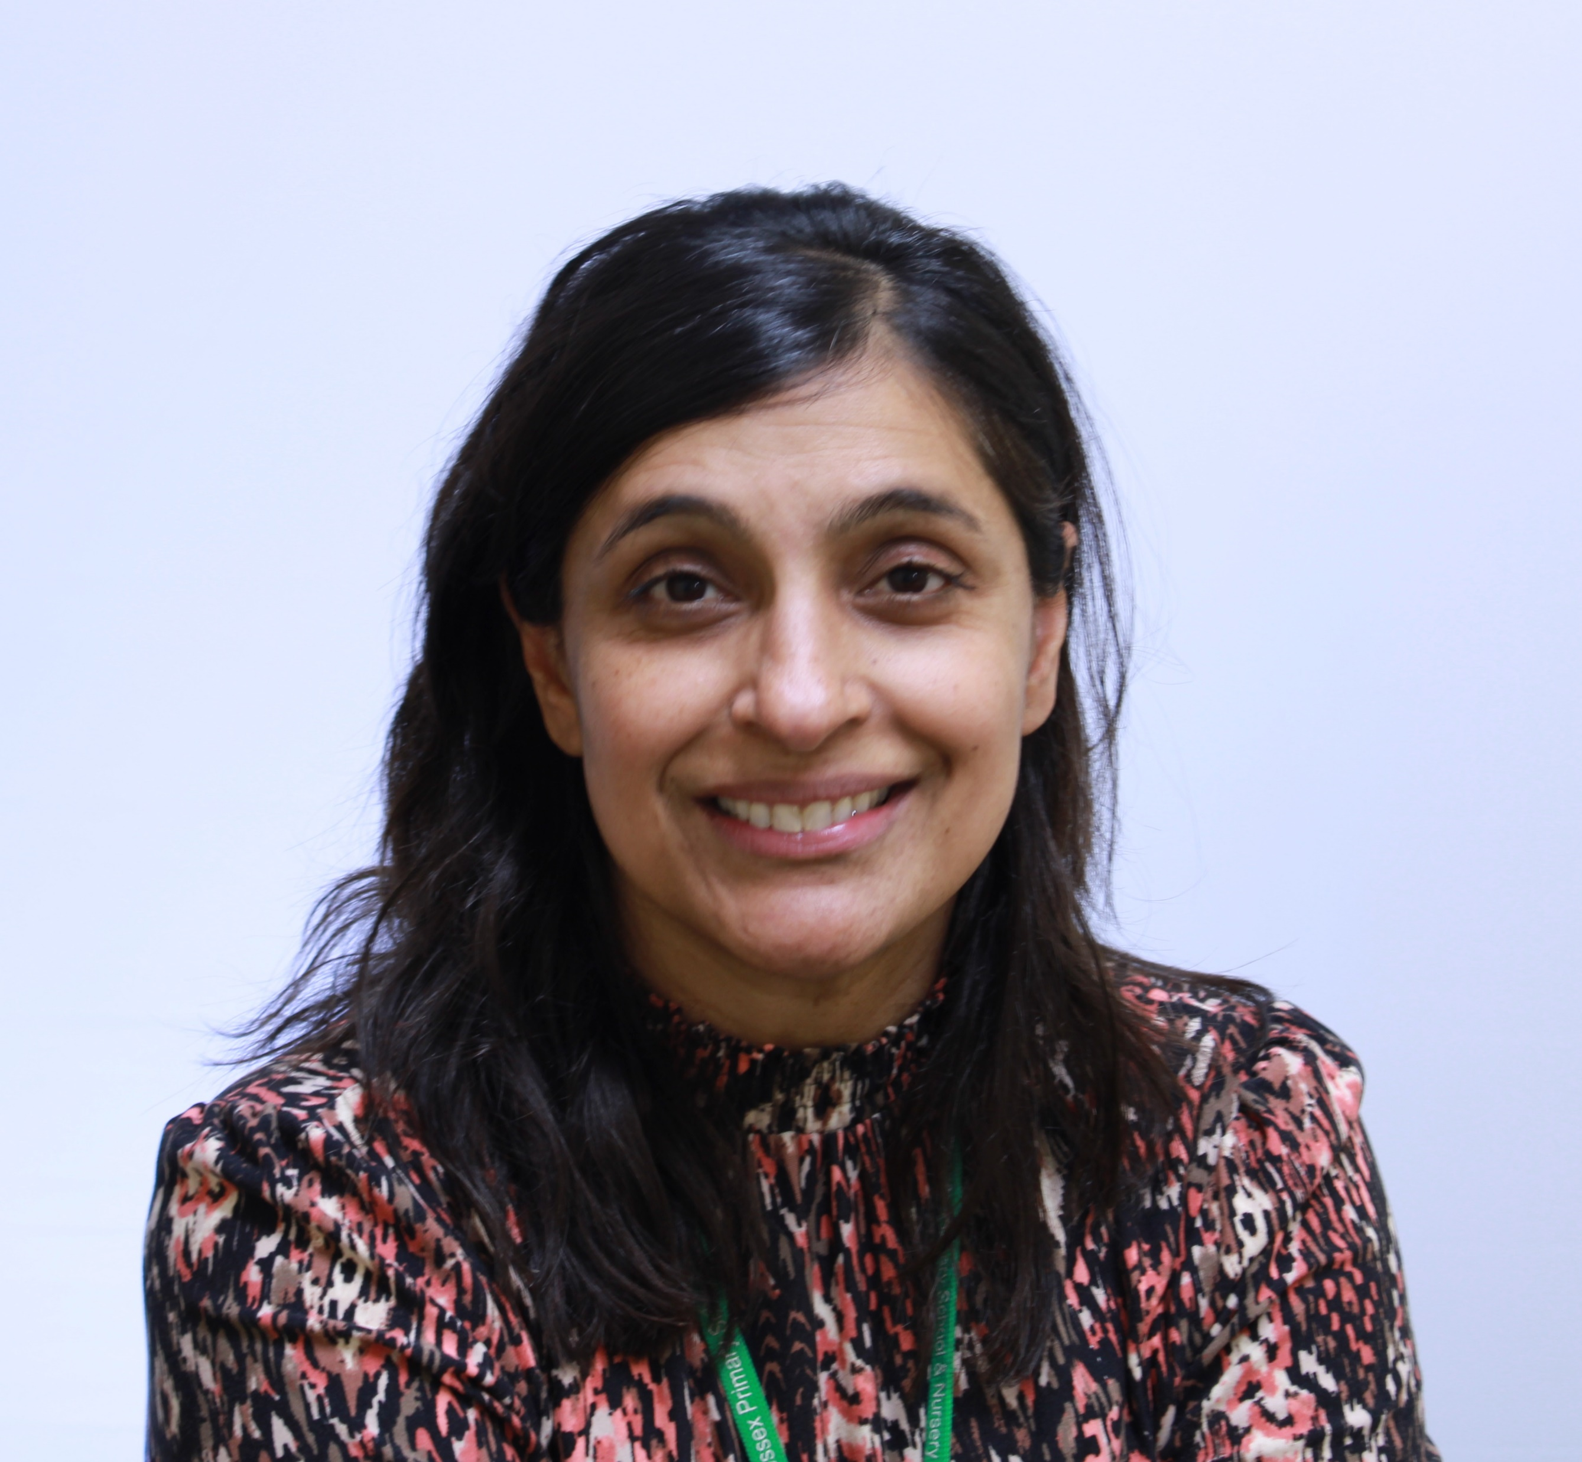
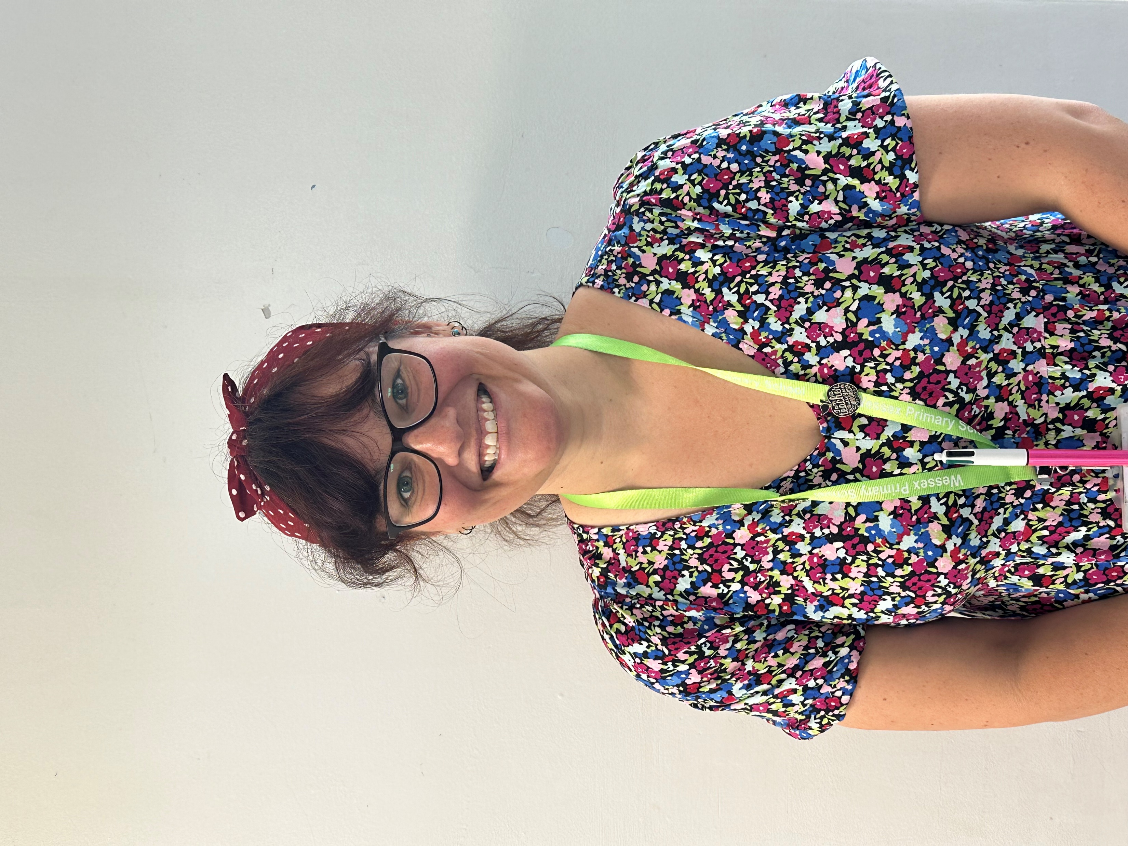
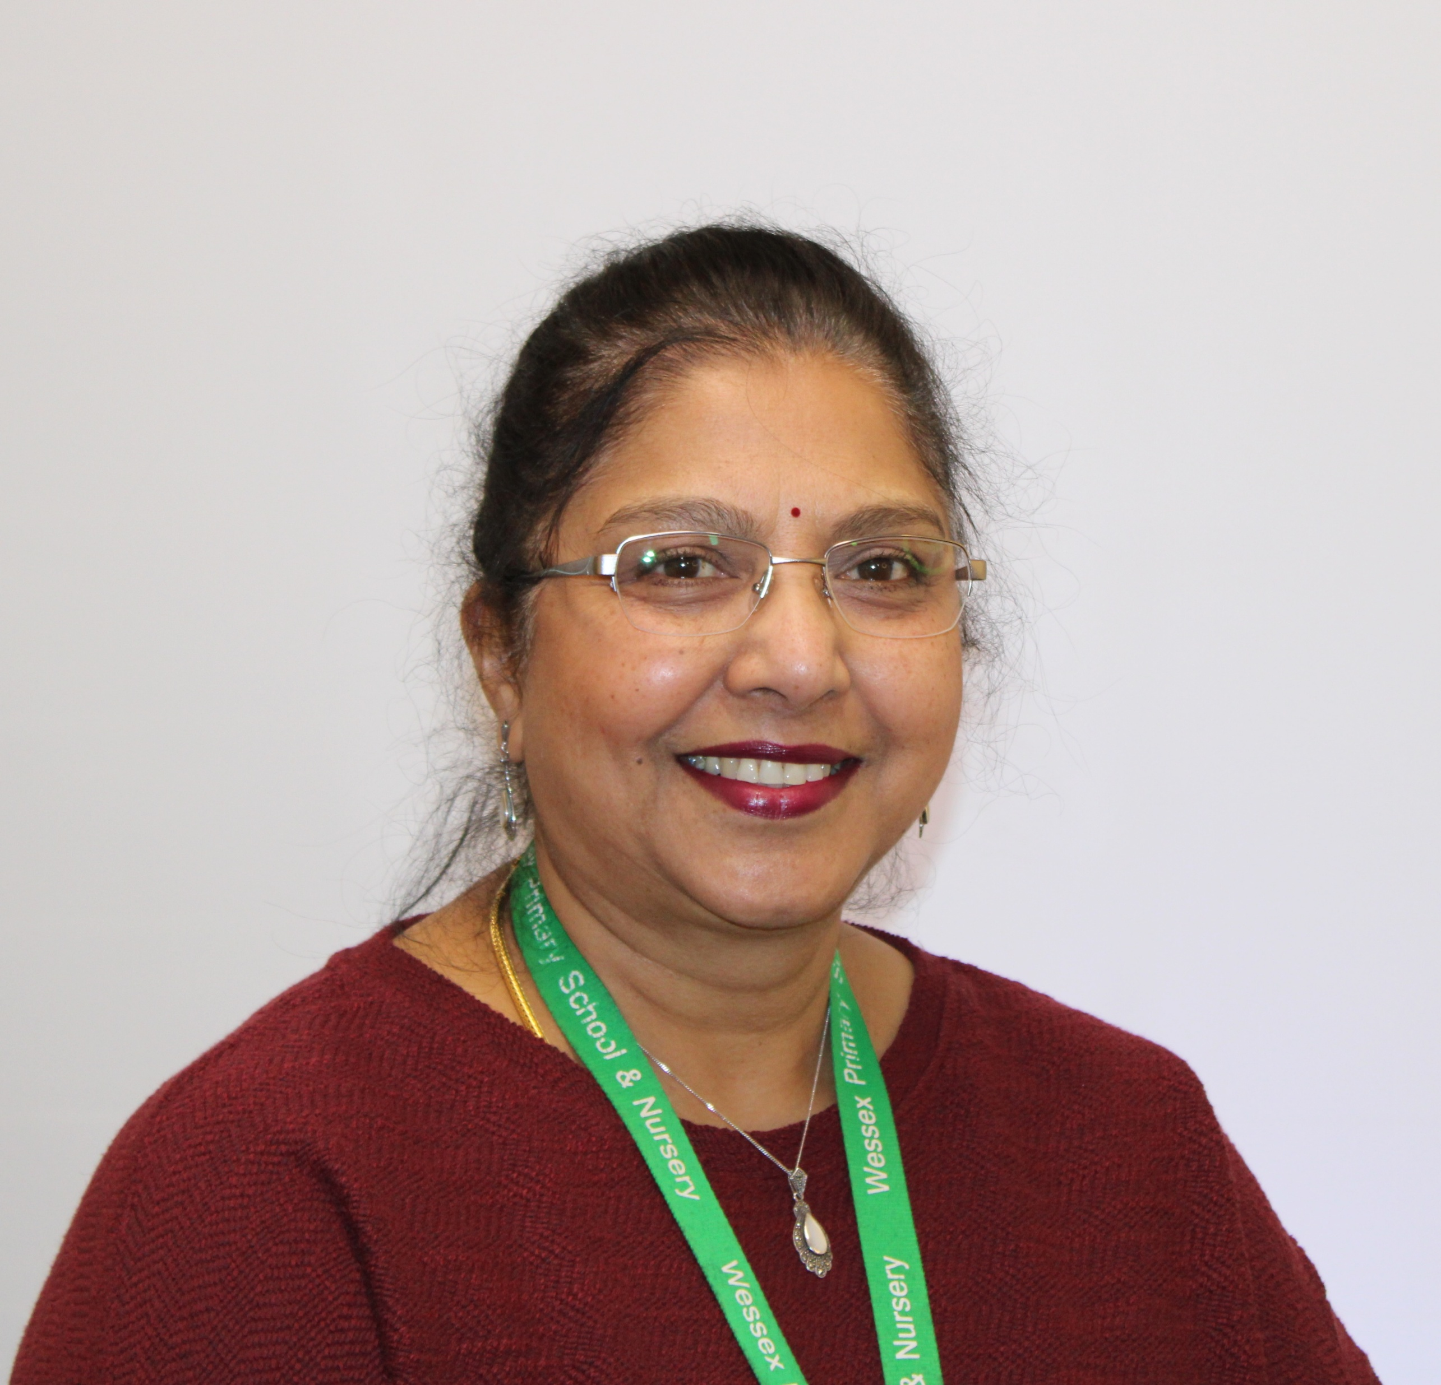
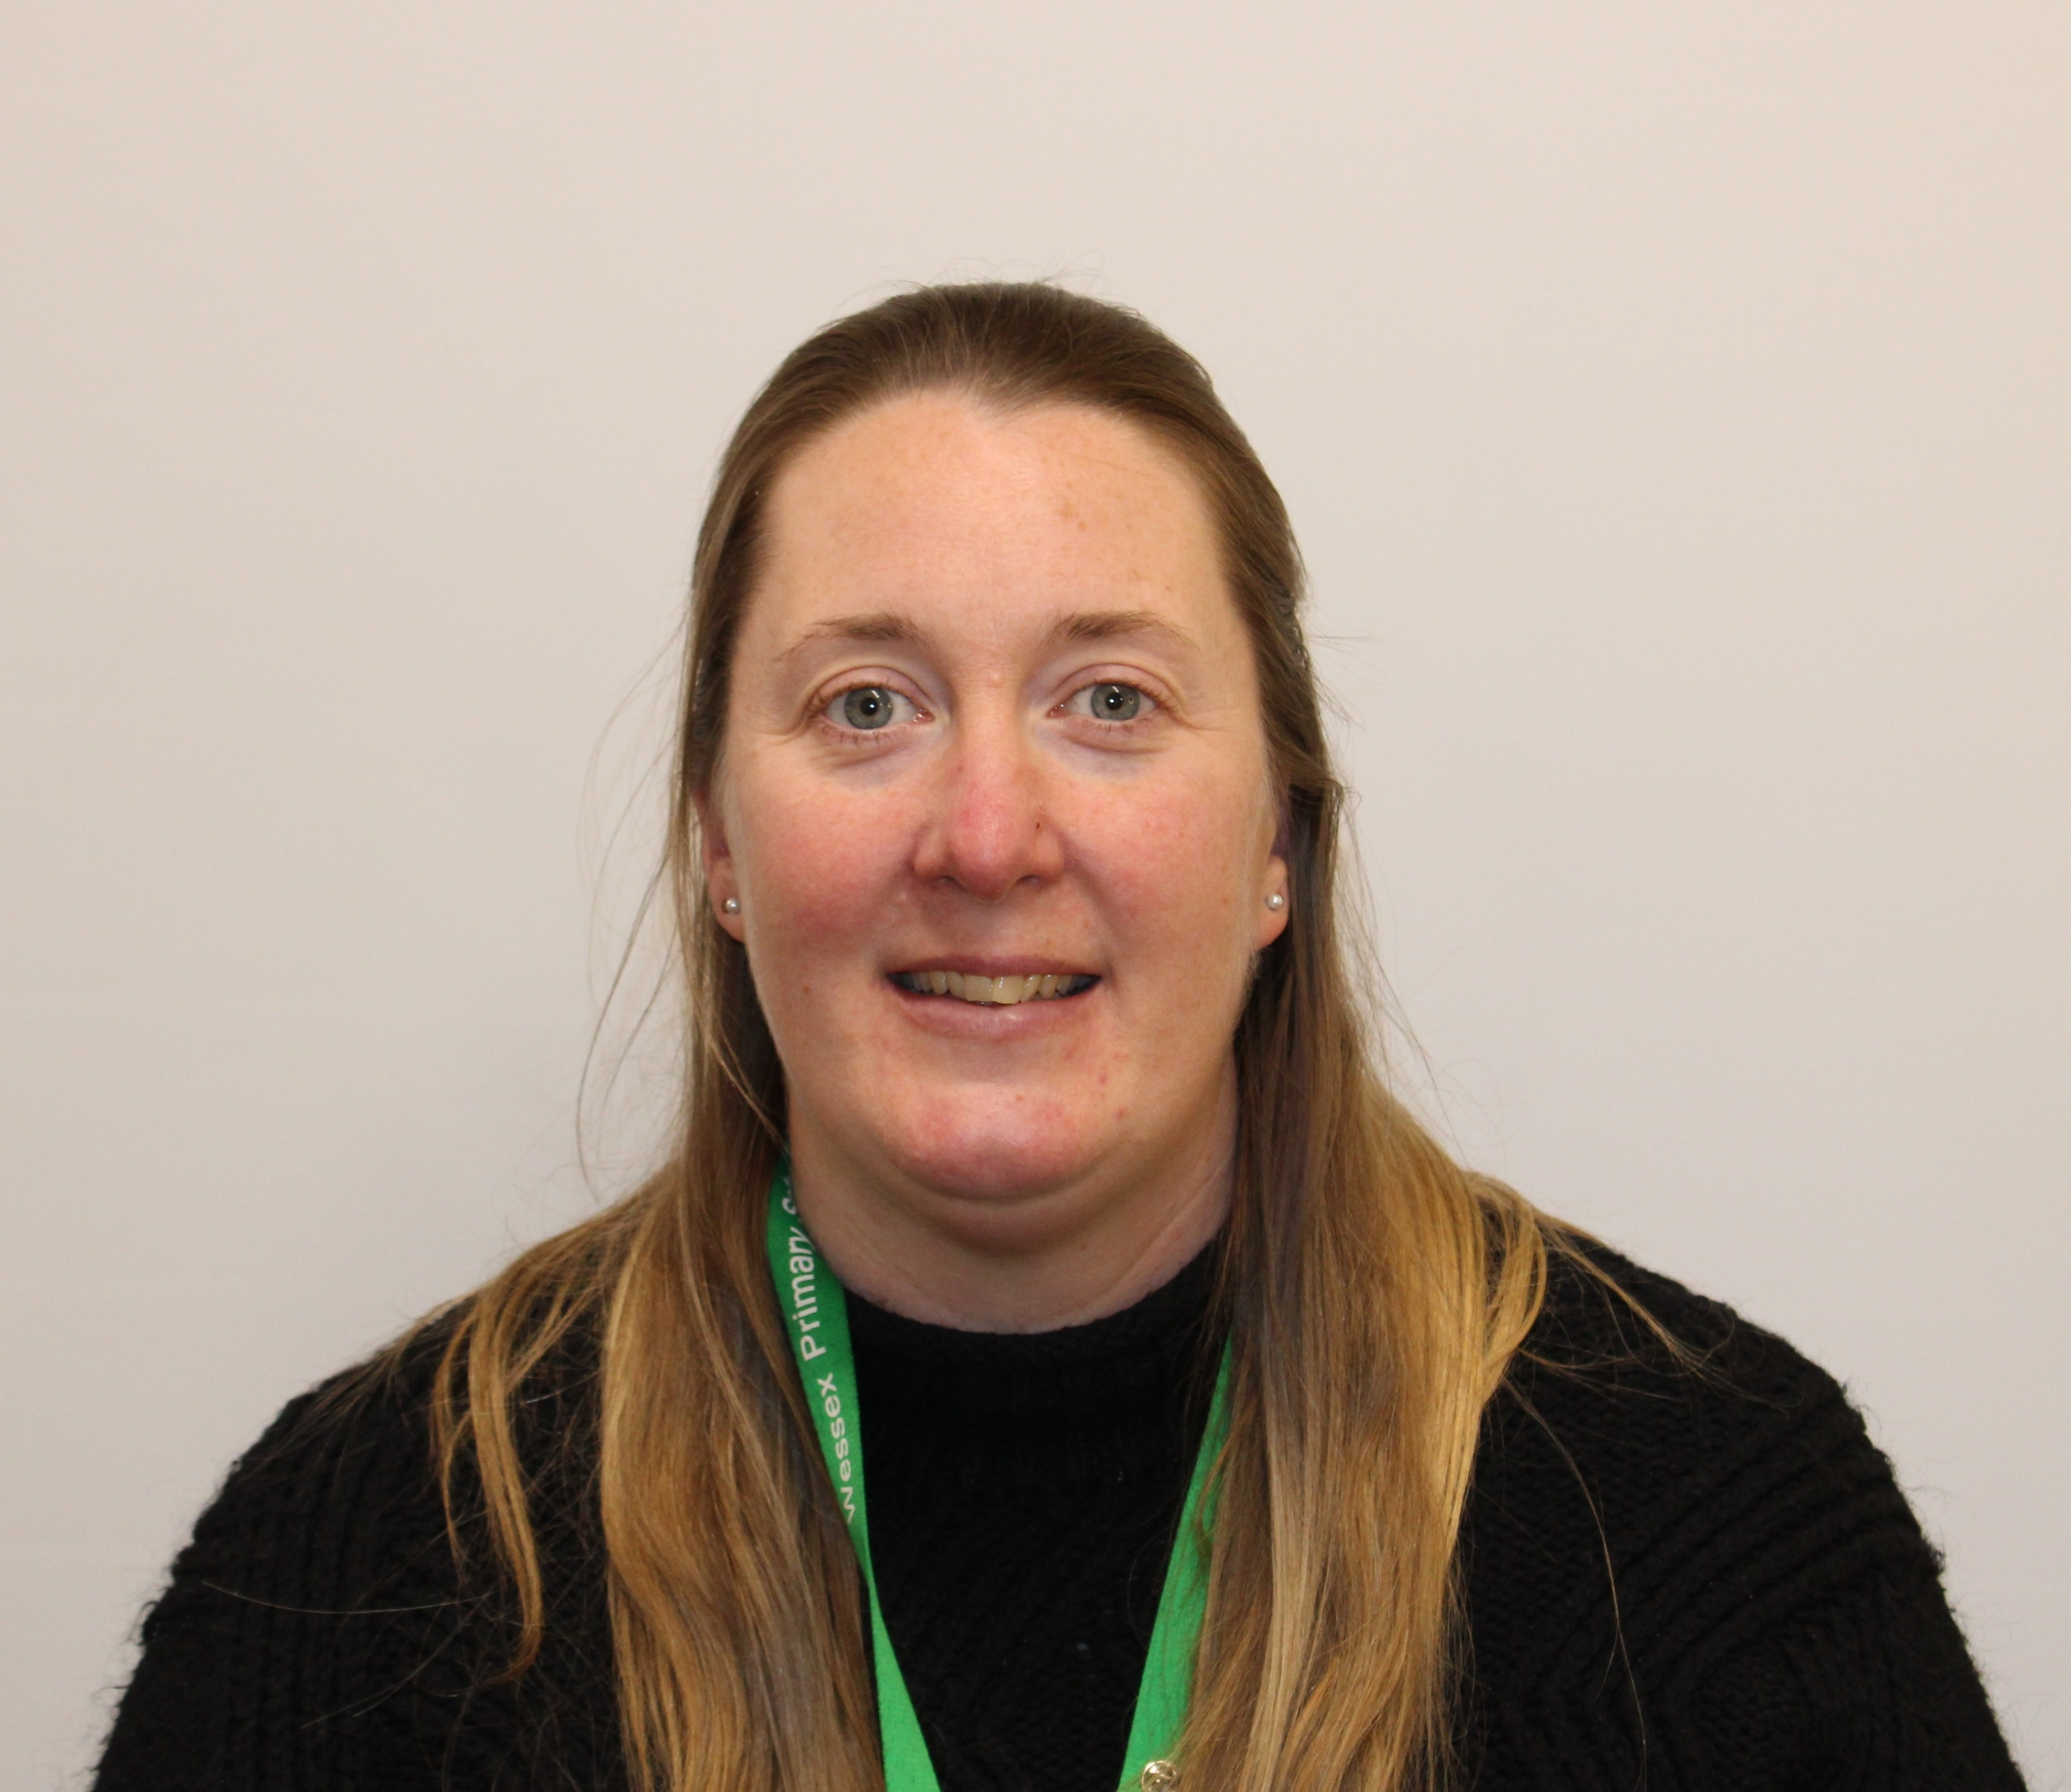
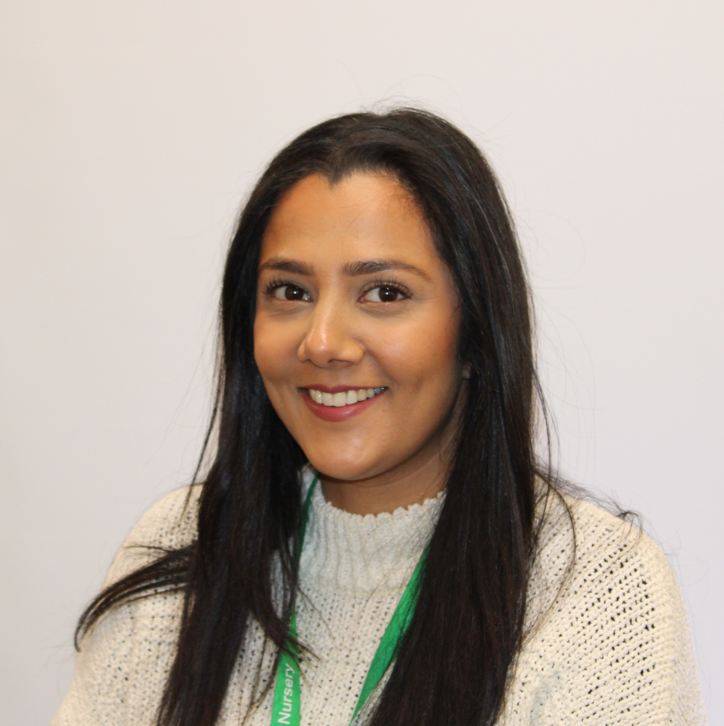
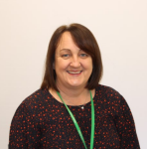
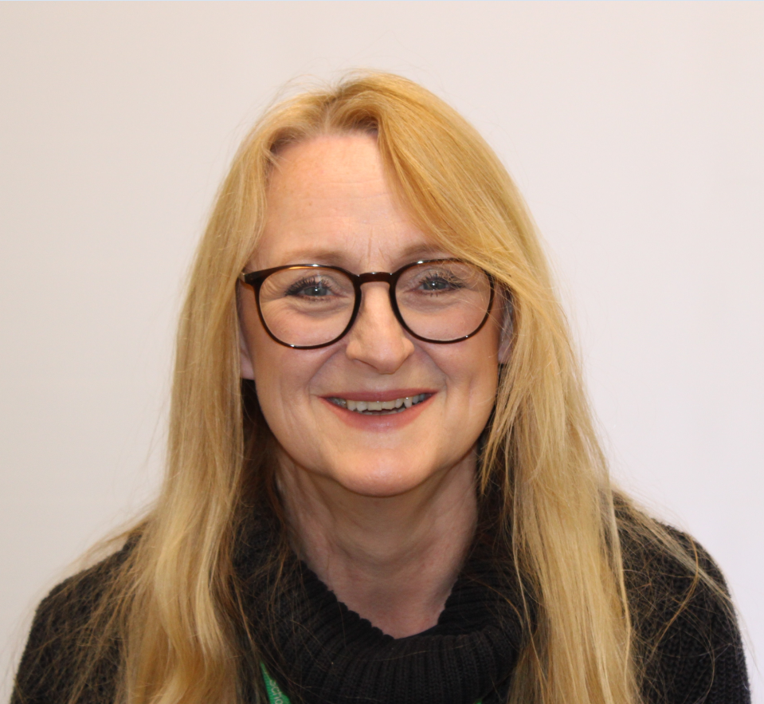
Staff
Wessex
Primary School
Mrs Cooke
Holly
Mrs Sandhar
Hazel
Mrs Stockdale
Hazel
Mrs Vee
PPA
Ms Mahmood
Mrs Richards
Ms Rowell
Notes:
11 November 2024 until 15 January 2025

Slide 3

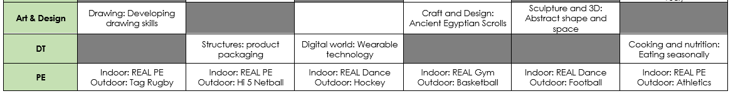
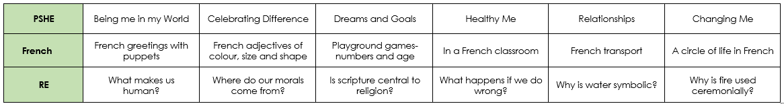
Curriculum Map
Wessex
Primary School
Notes:
11 November 2024 until 15 January 2025

Slide 4
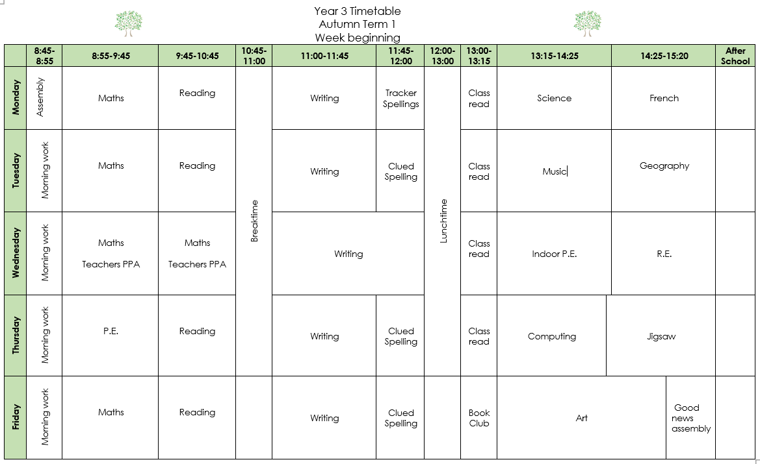
Timetable
Wessex
Primary School
Notes:
11 November 2024 until 15 January 2025

Slide 5
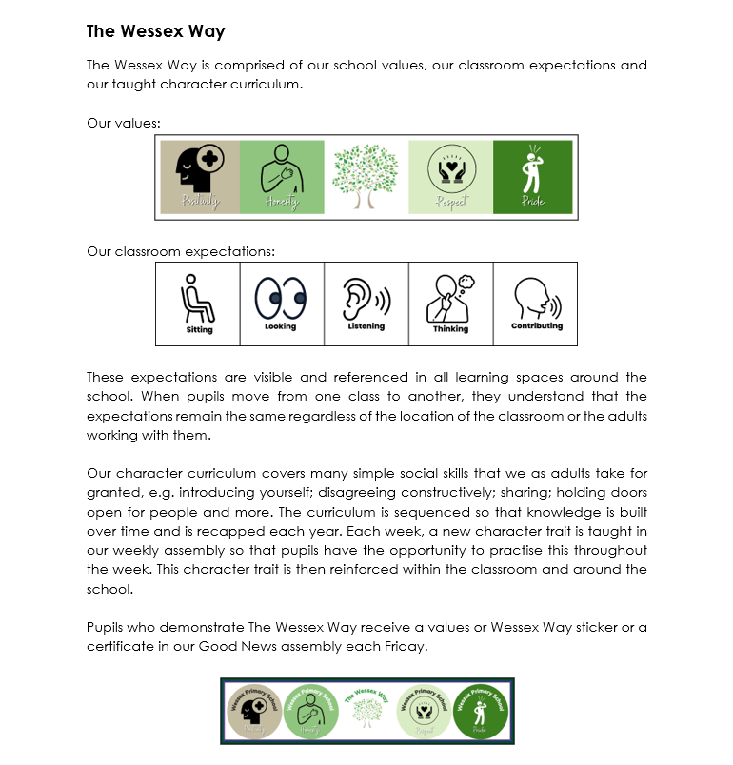
Behaviour
Wessex
Primary School
Notes:
11 November 2024 until 15 January 2025

Slide 6
Key Information
Wessex
Primary School
If you would like to bring a small pencil case for your desks, you can. This could include pencils, a glue stick, and a ruler (please try and name items)
Reading will still be recorded in a Reading record in addition to children quizzing on Accelerated Reader.
Homework will be completed in books which will be sent home weekly –Tuesday to Tuesday
Your children can use Times Table Rock Stars at home to practise the times tables we will be learning in school.
Notes:
11 November 2024 until 15 January 2025

Slide 7
Key Information
Wessex
Primary School
PE days for Term 1 are Wednesday (indoor) and Thursday (outdoor)
Please can your child come in wearing appropriate named uniform for school – stud earrings only, black shoes/trainers
We are hoping to go on a trip to Ufton Court in Term 4 and hold a Roman day in Term 6.
Notes:
11 November 2024 until 15 January 2025

Slide 8
Attendance
Wessex
Primary School
School target of 97%
There are 190 days that children should attend school each year
5 days off a year will give a child an attendance of 97%
Children should attend school with coughs and colds
Medical evidence will be asked for excessive absences relating to illness
No holidays, birthdays or trips away can be authorised
Punctuality is being monitored more closely this year
Meetings with senior leaders will take place if low attendance or poor punctuality
Penalty notices (fines) are issued for excessive unauthorised absence
Notes:
11 November 2024 until 15 January 2025

