Slide 1


Wessex
Primary School
Year 5 Pine & Poplar
September 2026-2027

Slide 2

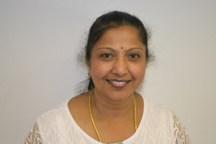
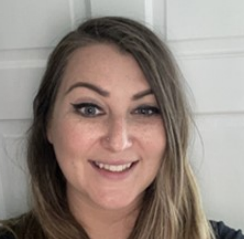
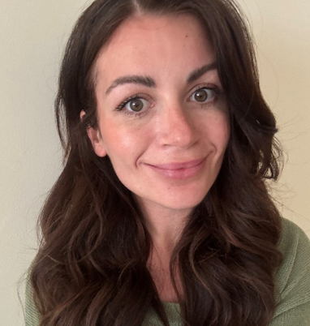
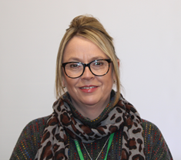
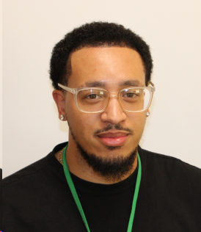

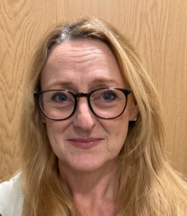
Staff
Wessex
Primary School
Mrs Hussain– Poplar
Mrs Szablowski (PPA)
Mrs Vee (PPA)
Mrs Ashby- Pine
Mrs Philips
Mr Randall
Mrs Hillbourne
Ms Rowell
Notes:
11 November 2024 until 15 January 2025

Slide 3
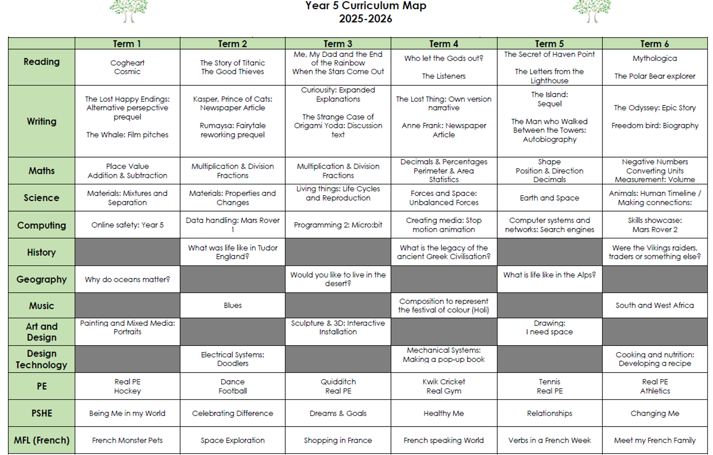
Curriculum Map
Wessex
Primary School
Notes:
11 November 2024 until 15 January 2025

Slide 4
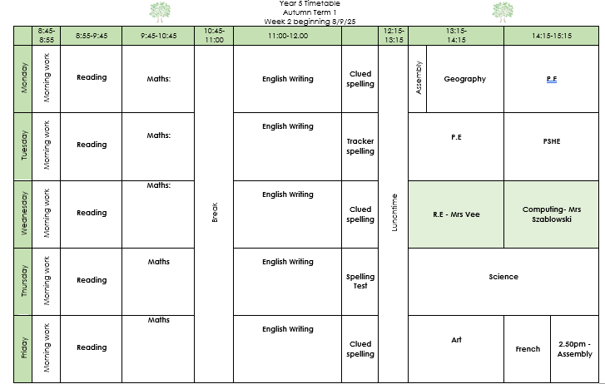
Timetable
Wessex
Primary School
Notes:
11 November 2024 until 15 January 2025

Slide 5

Behaviour
Wessex
Primary School
Notes:
11 November 2024 until 15 January 2025

Slide 6
Key Information
Wessex
Primary School
Small pencil case with essential equipment: pencil, blue handwriting pen, rubber, sharpener, green editing pen, glue stick, whiteboard pen – No scissors
PE days for Term 1 – Monday – outdoors
Tuesday - Indoors
Mobile Phones need to be handed in to teachers in the morning, and they will be given back to your child at home time to use off site.
Uniform reminder - https://www.wessexprimary.org/uniform/
Notes:
11 November 2024 until 15 January 2025

Slide 7
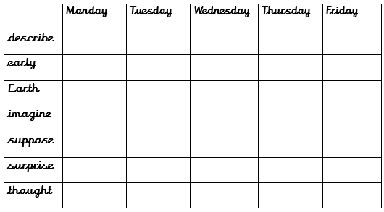

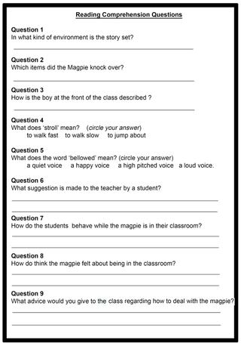

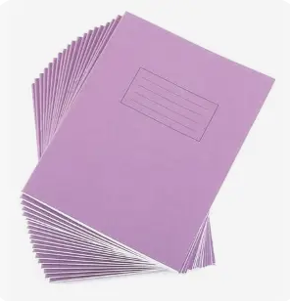
Key Information
Wessex
Maths activity weekly
Spellings
Primary School
Home Learning
15-20 mins reading daily and complete quiz in school
Log in daily - timetables
practise
Reading comprehension weekly
Notes:
11 November 2024 until 15 January 2025

Slide 8
Key Information
Wessex
Primary School
Music – Singing at the Hexagon in Spring
Trip linked to the Viking topic Summer Term: date tbc
Ancient Greek Day - dress up and activities linked to Ancient Greek Civilisation Spring Term: date tbc
Cycling proficiency – Summer term
Notes:
11 November 2024 until 15 January 2025

Slide 9
Attendance
Wessex
Primary School
School target of 97%
There are 190 days that children should attend school each year
5 days off a year will give a child an attendance of 97%
Children should attend school with coughs and colds
Medical evidence will be asked for excessive absences relating to illness
No holidays, birthdays or trips away can be authorised
Punctuality is being monitored more closely this year
Meetings with senior leaders will take place if low attendance or poor punctuality
Penalty notices (fines) are issued for excessive unauthorised absence
Notes:
11 November 2024 until 15 January 2025

