Slide 1


Wessex
Primary School
Year 1 Birch
September 2026-27

Slide 2
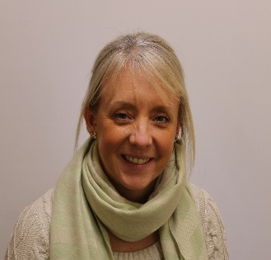
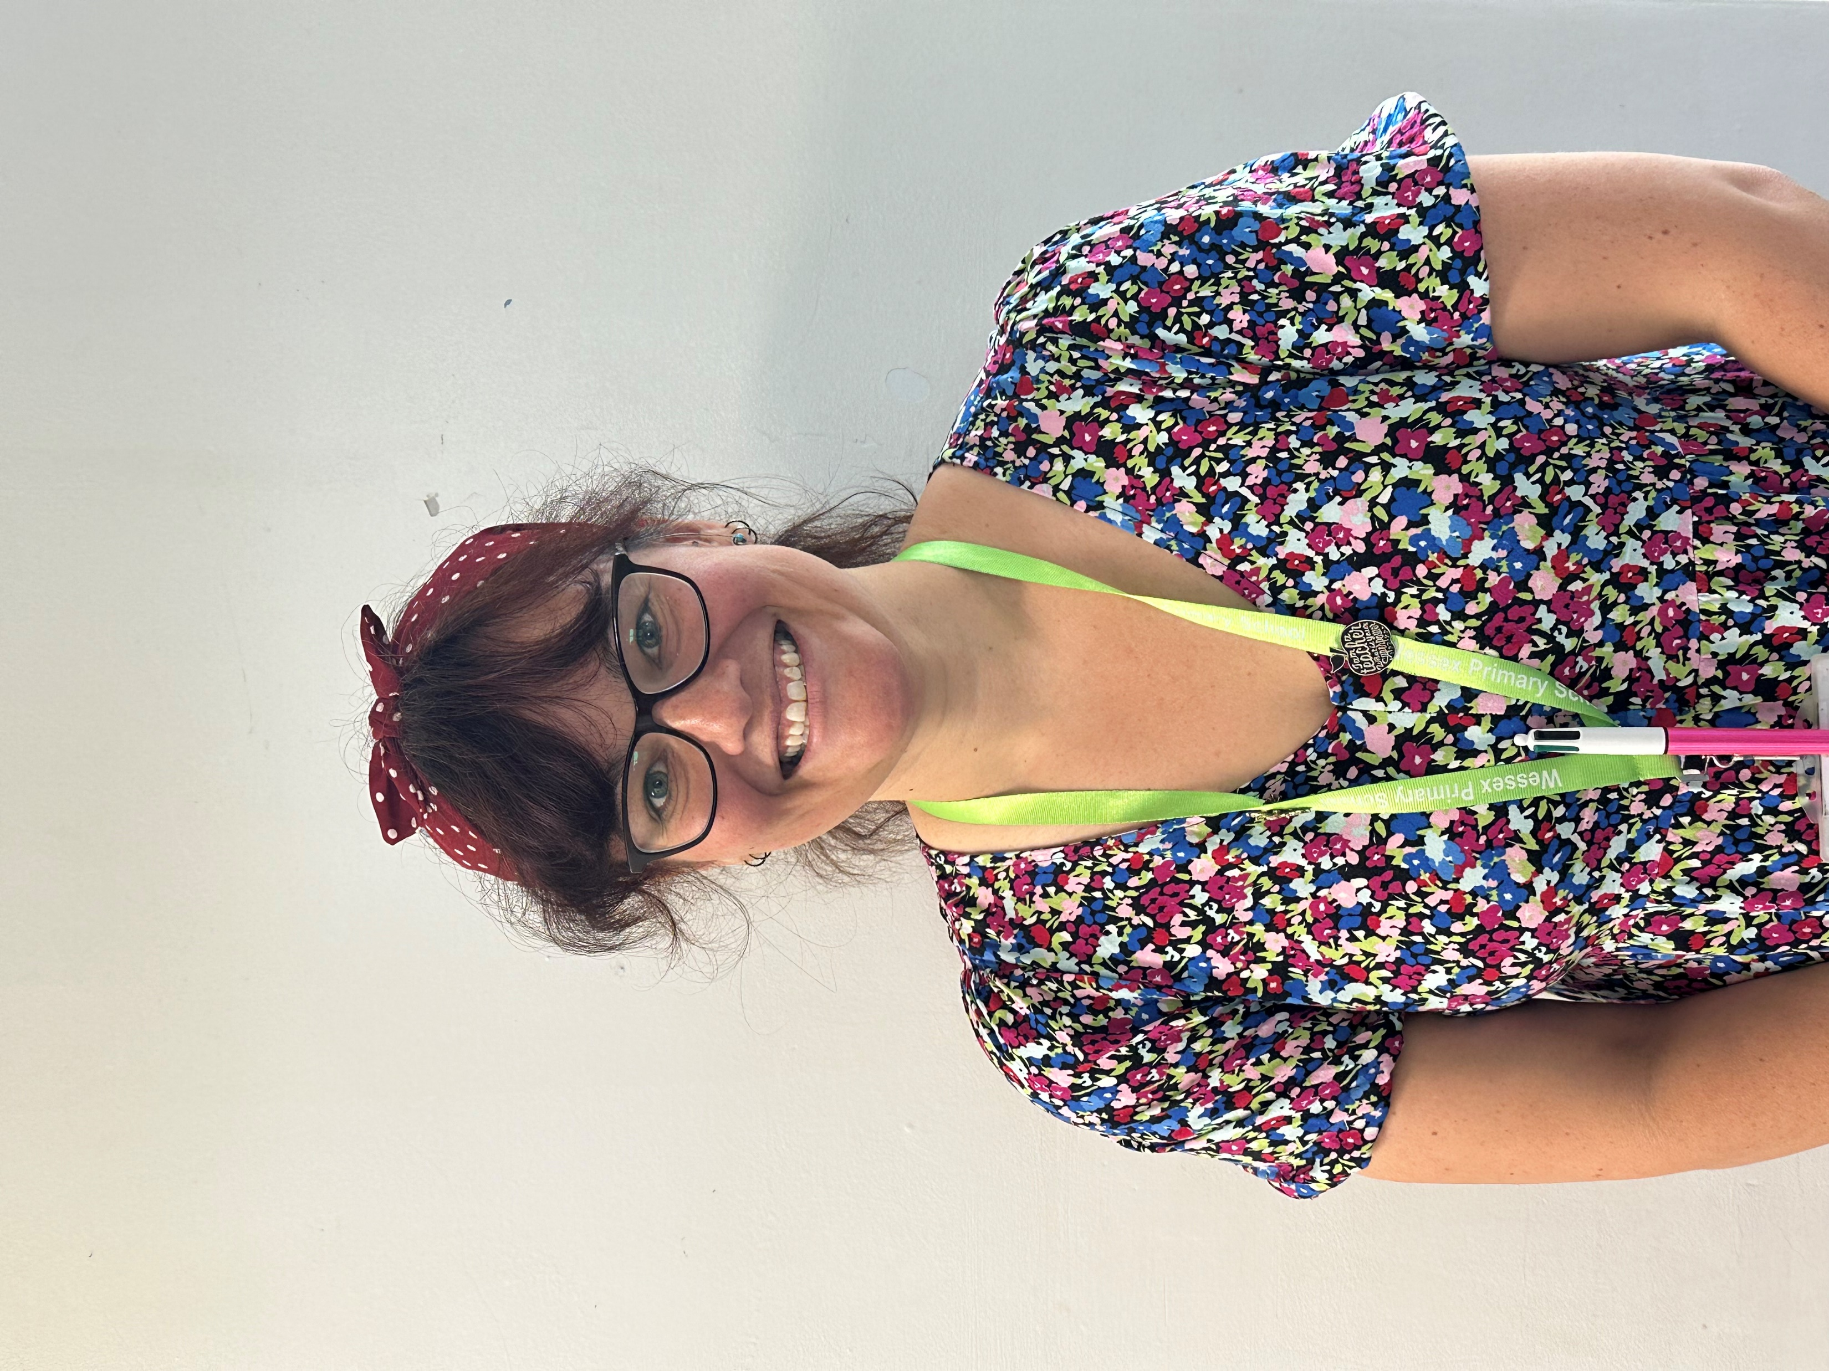
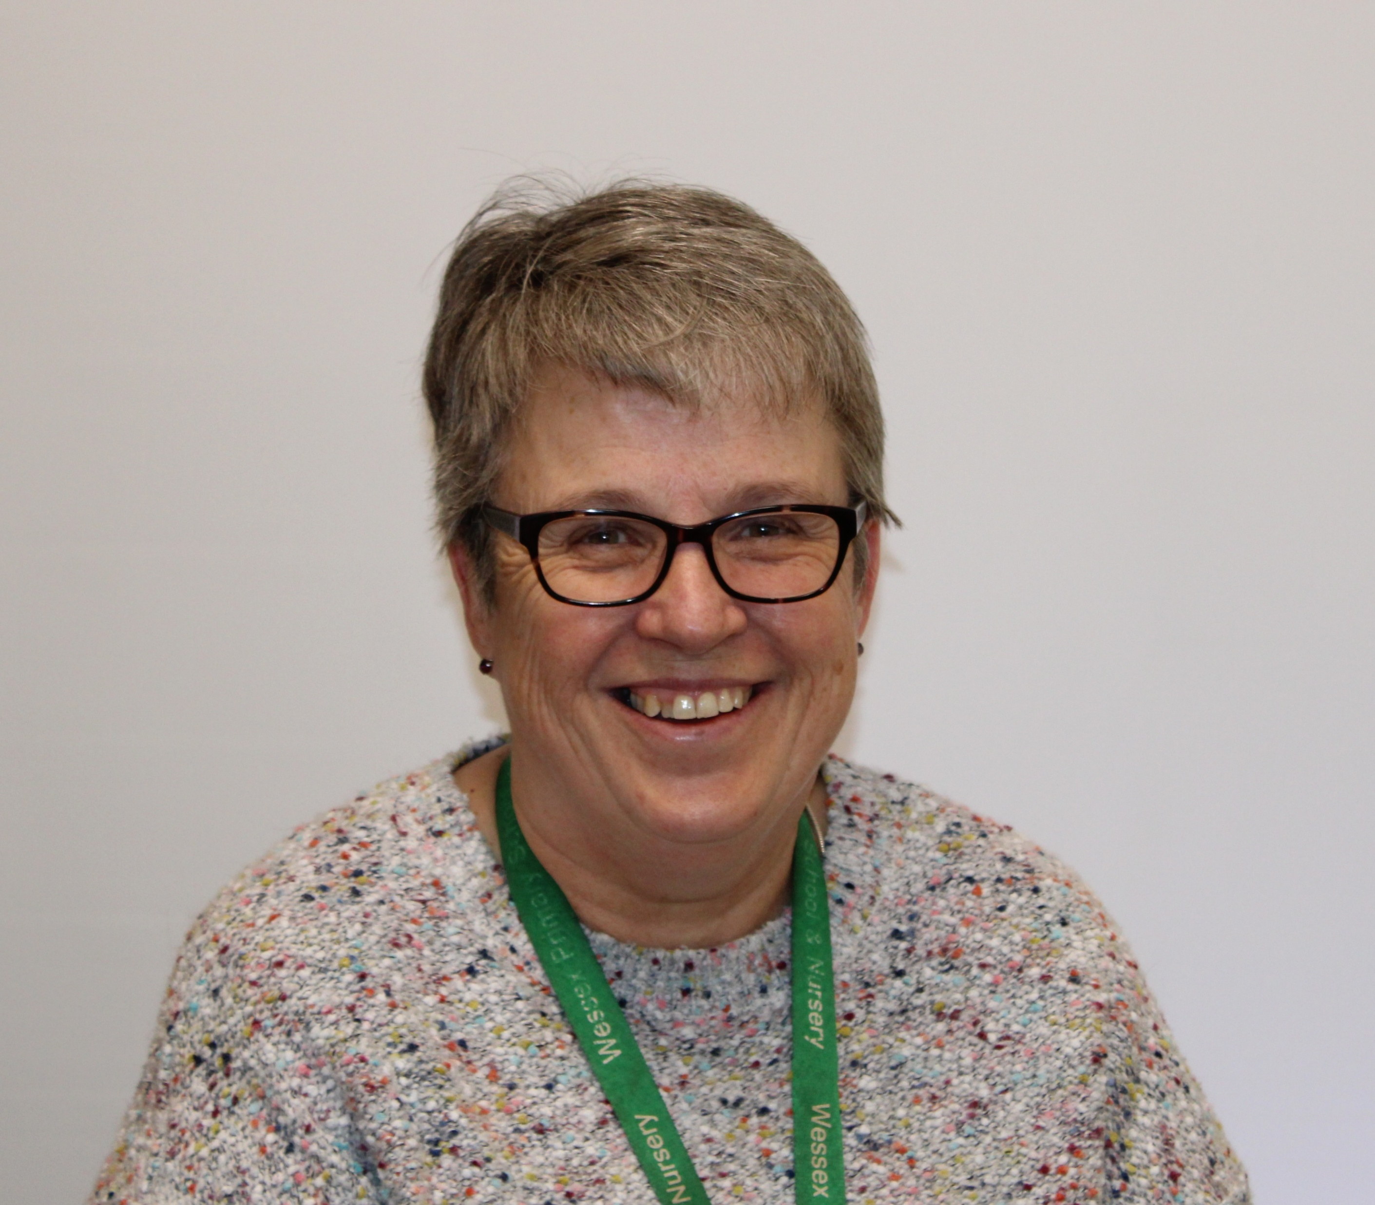
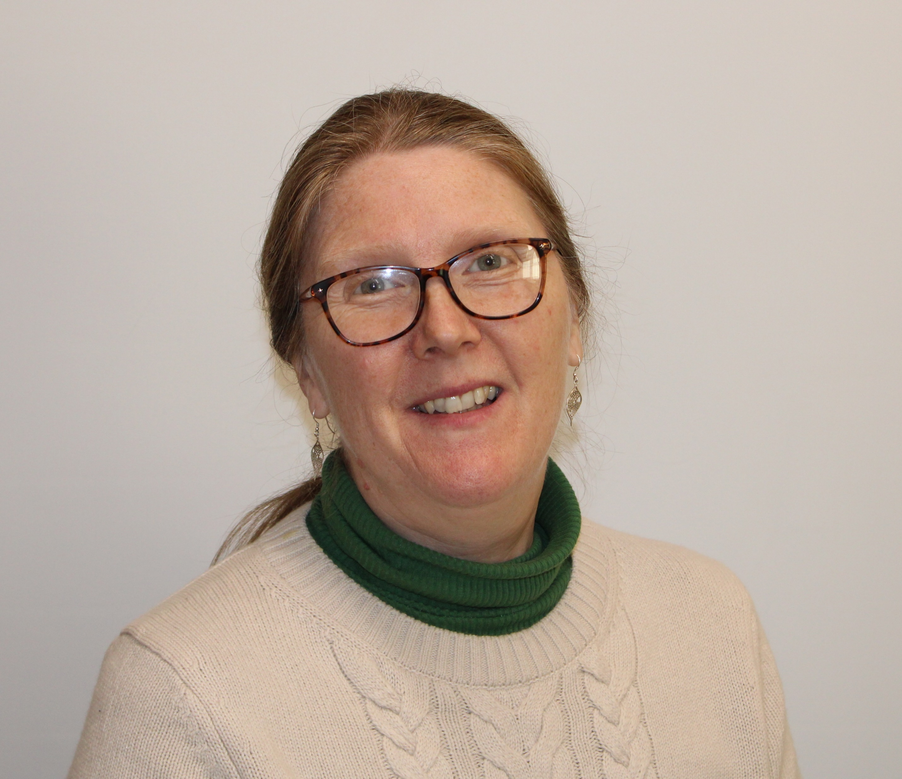
Staff
Wessex
Primary School
Teacher
Mrs Eves
Monday to Thursday
Mrs Weaver
Mrs Taylor
Teacher
Mrs Stockdale Friday
Notes:
11 November 2024 until 15 January 2025

Slide 3
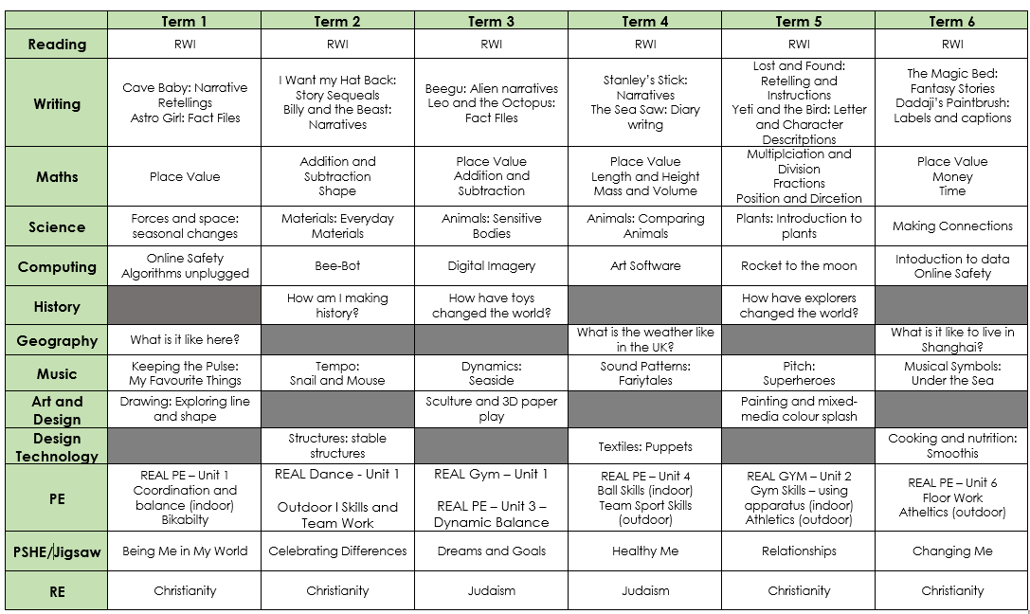
Curriculum Map
Wessex
Primary School
Notes:
11 November 2024 until 15 January 2025

Slide 4
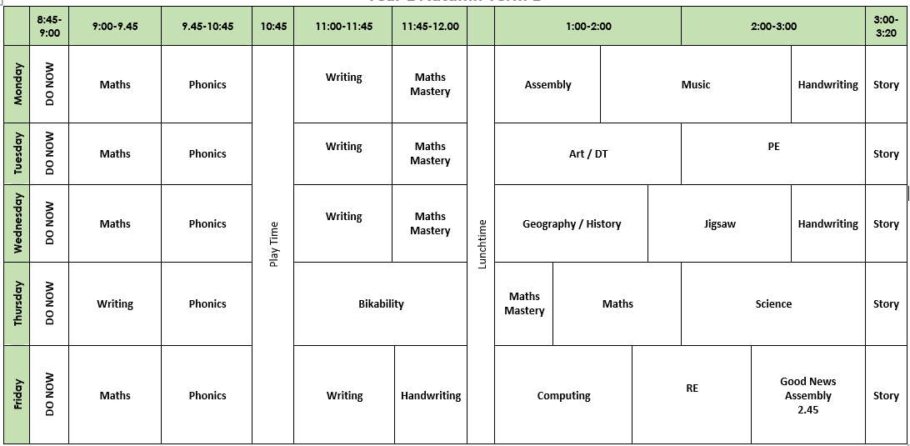
Timetable
Wessex
Primary School
Notes:
11 November 2024 until 15 January 2025

Slide 5

Behaviour
Wessex
Primary School
Notes:
11 November 2024 until 15 January 2025

Slide 6
Key Information
Wessex
Primary School
No need to have pencil cases
Folders to be returned every Wednesday. Handed out Thursday.
Homework on Seesaw (Phonics and Maths), Num Bots. Set Wednesdays
Phonics Screening Check in June for all Y1 children
PE days – Tuesday + Thursday (Bikability Term 1)
Uniform reminder
Trips and visitors – one per term
Notes:
11 November 2024 until 15 January 2025

Slide 7
Attendance
Wessex
Primary School
School target of 97%
There are 190 days that children should attend school each year
5 days off a year will give a child an attendance of 97%
Children should attend school with coughs and colds
Medical evidence will be asked for excessive absences relating to illness
No holidays, birthdays or trips away can be authorised
Punctuality is being monitored more closely this year – 8.45am start is encouraged due to tasks set in class
Meetings with senior leaders will take place if low attendance or poor punctuality
Penalty notices (fines) are issued for excessive unauthorised absence
Notes:
11 November 2024 until 15 January 2025

