Slide 1


Wessex
Primary School
Year 4 Larch & Lime
September 2026-2027

Slide 2
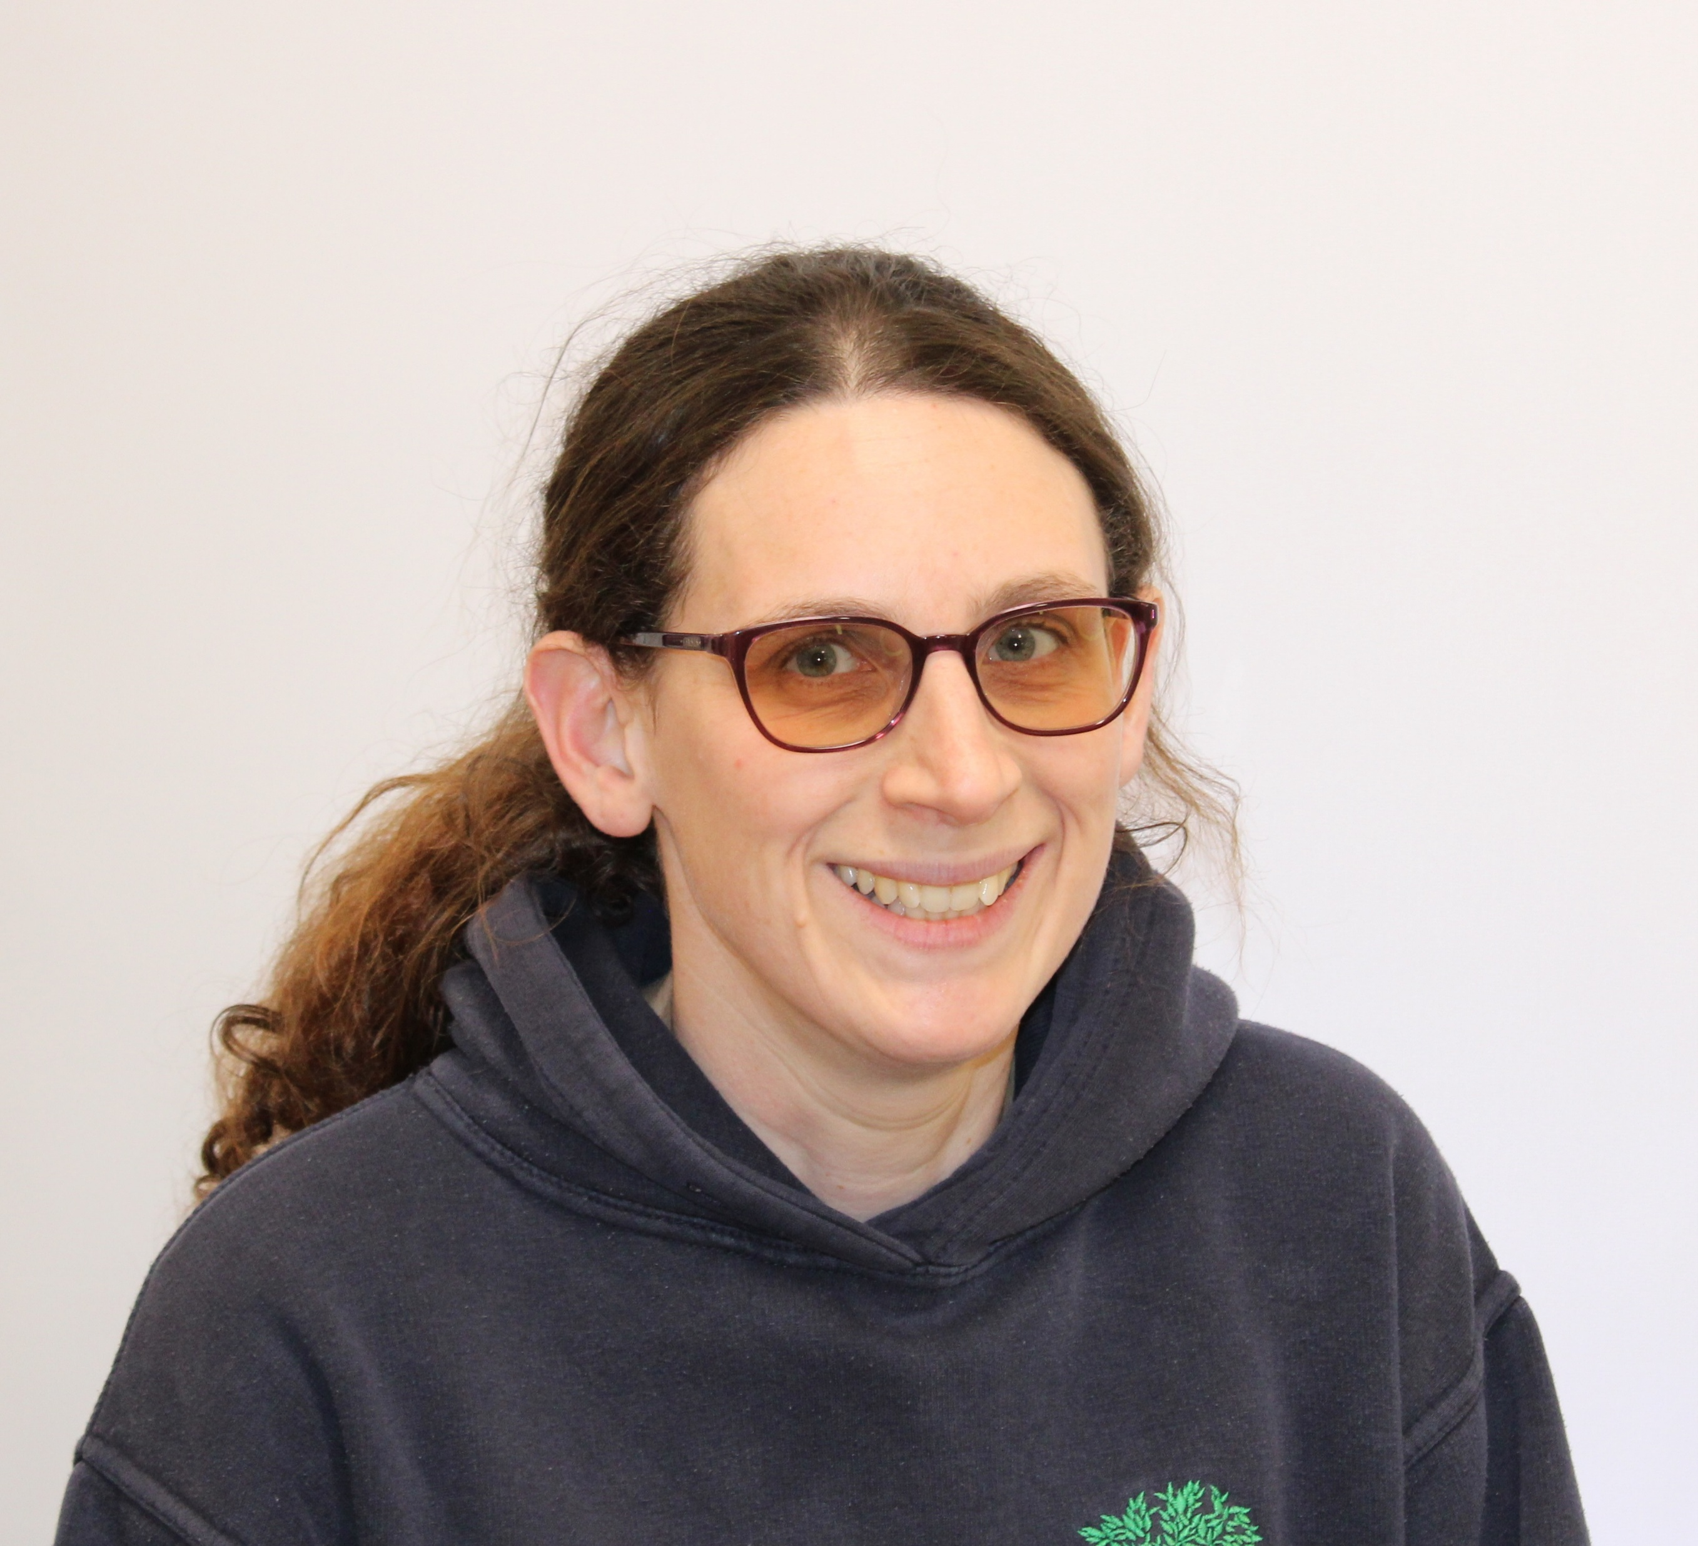

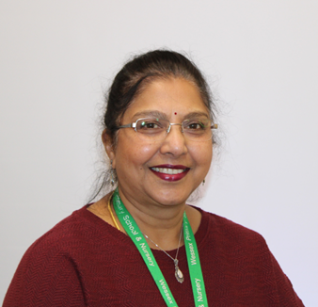
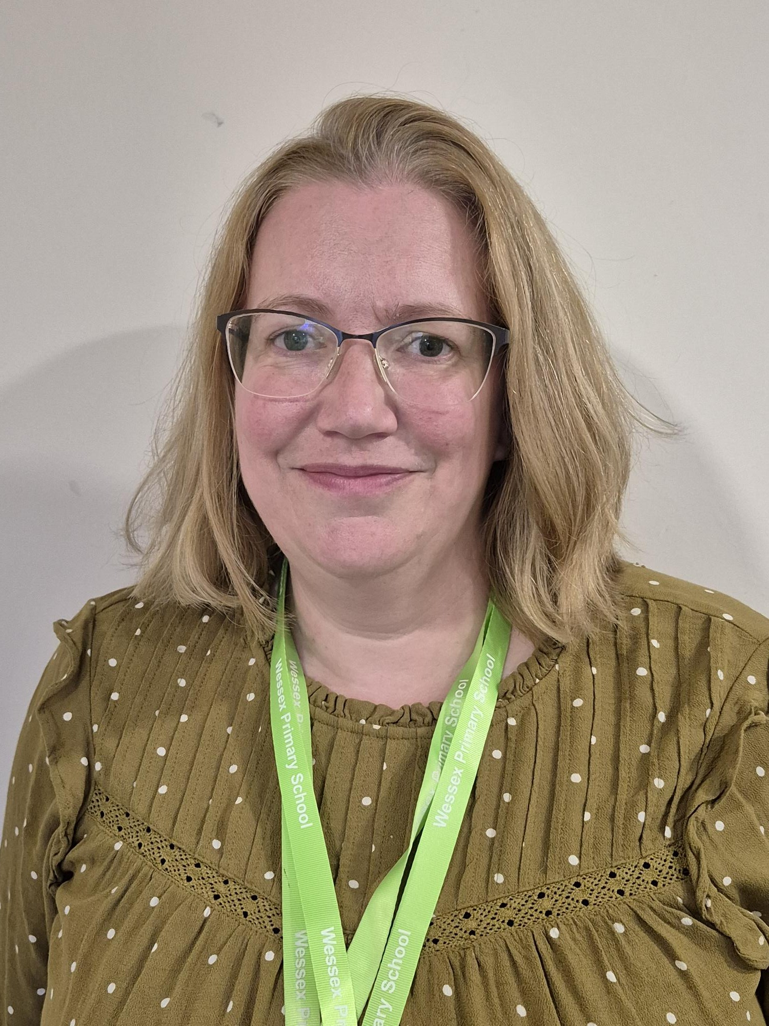
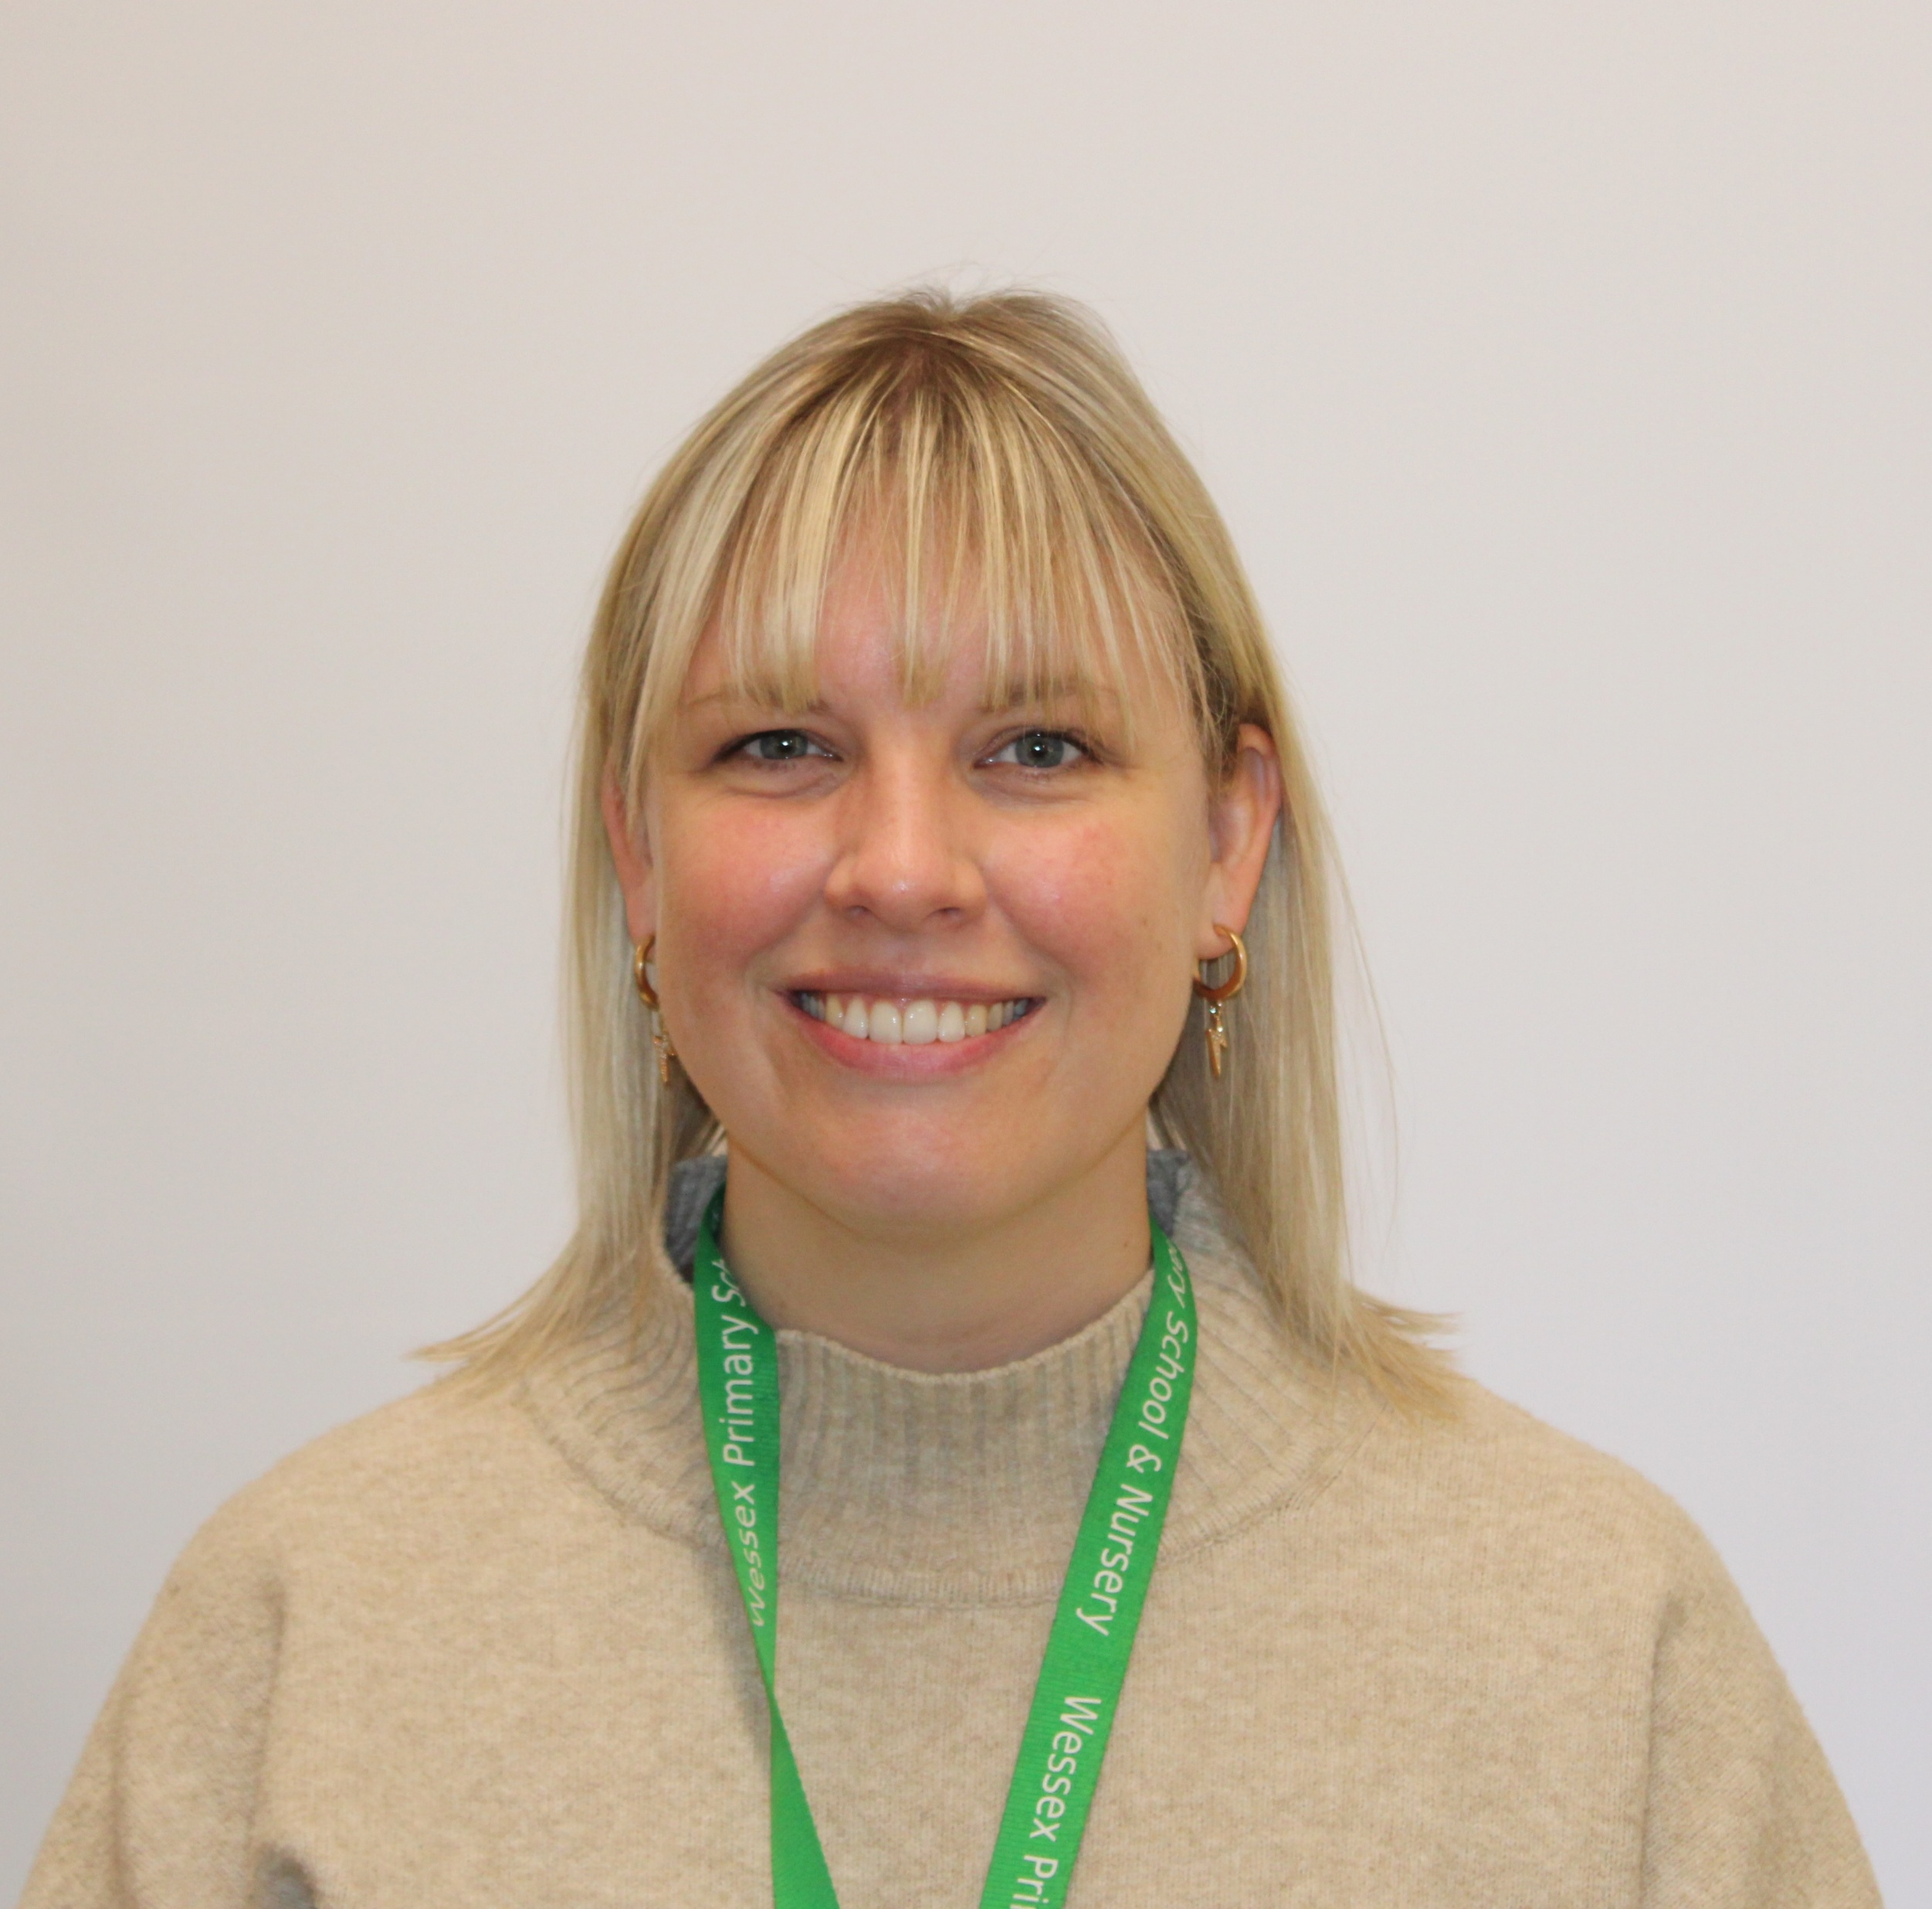
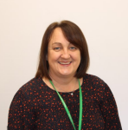
Staff
Wessex
Primary School
Mrs Alfred Mon-Wed
Larch Class
Mrs Szablowski Thu-Fri
Larch Class
Mrs Cameron
Lime Class
Mrs Vee
PPA
Mrs Patrick
Mrs Richards
Notes:
11 November 2024 until 15 January 2025

Slide 3
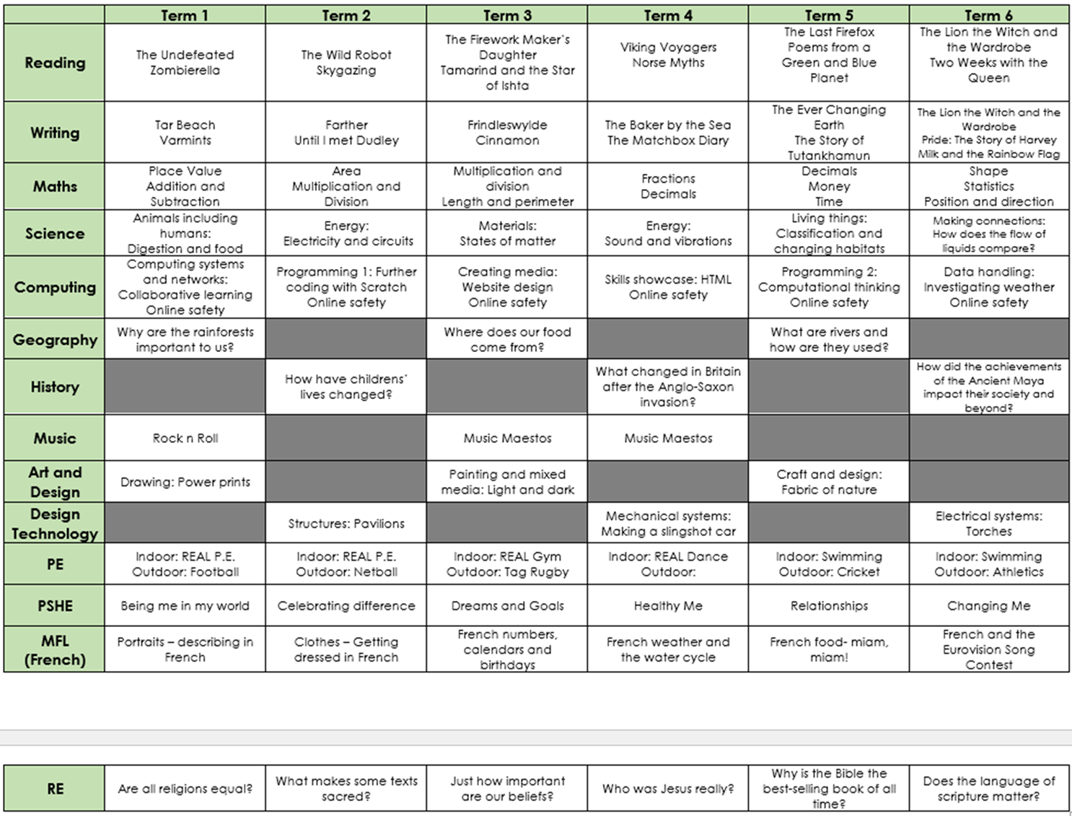
Curriculum Map
Wessex
Primary School
Notes:
11 November 2024 until 15 January 2025

Slide 4
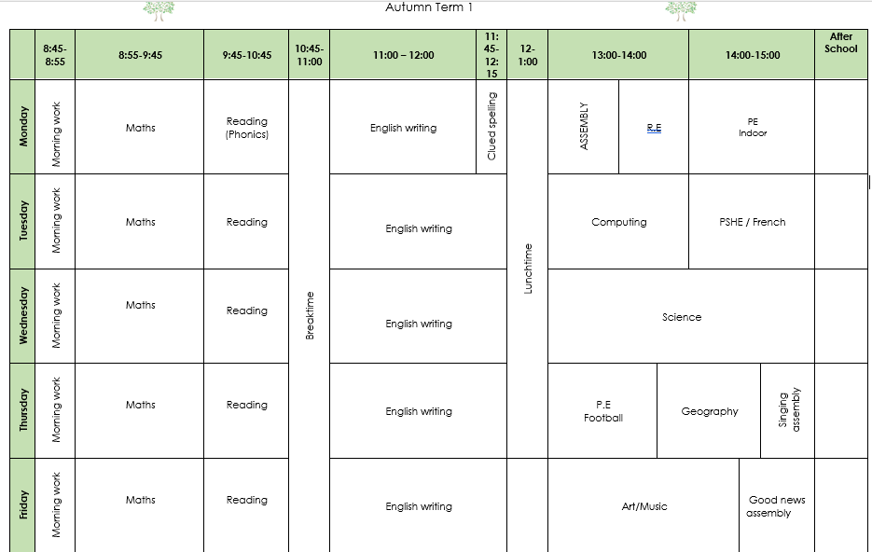
Timetable
Wessex
Primary School
Notes:
11 November 2024 until 15 January 2025

Slide 5

Behaviour
Wessex
Primary School
Notes:
11 November 2024 until 15 January 2025

Slide 6
Key Information
Wessex
Primary School
Year 4
If your child would like to bring a small pencil case for their personal equipment, they can. This could include pencils, a glue stick, and a ruler (please try and name items).
We will set weekly maths, English and spelling homework in a book.
Reading will still be recorded via Accelerated Reader.
Your children will be expected to use Times Table Rock Stars at home to practise their times tables.
MTC will be in the summer term. This is the government times tables test.
Notes:
11 November 2024 until 15 January 2025

Slide 7
Key Information
Wessex
Primary School
Year 4
Swimming will be in the summer term.
PE days for Term 1 are Monday (indoor) and Thursday (outdoor).
Please can your child come in wearing appropriate named uniform for school – stud earrings will need to be taped, black shoes/trainers.
Jonathan’s Jungle Roadshow.
Tissues
Notes:
11 November 2024 until 15 January 2025

Slide 8
Attendance
Wessex
Primary School
School target of 97%
There are 190 days that children should attend school each year
5 days off a year will give a child an attendance of 97%
Children should attend school with coughs and colds
Medical evidence will be asked for excessive absences relating to illness
No holidays, birthdays or trips away can be authorised
Punctuality is being monitored more closely this year in line with government guidance
Meetings with senior leaders will take place if low attendance or poor punctuality
Penalty notices (fines) are issued for excessive unauthorised absence
Notes:
11 November 2024 until 15 January 2025

