Slide 1


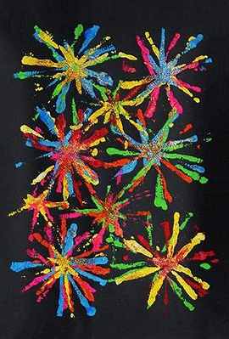


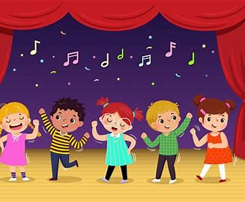
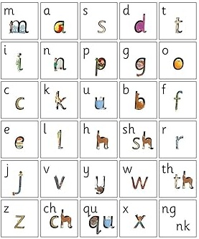

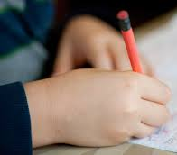
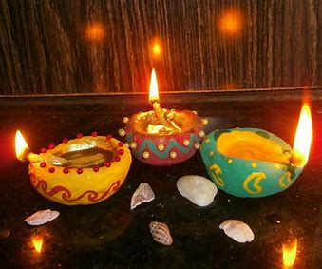


AUTUMN 2 RECEPTION 2026
Expressive Arts and Design
I can use paints to represent lights and sounds
I can use percussion instruments to make different sounds
I can learn festive songs off by heart
I love maths
I can continue repeating patterns and create my own patterns
I can represent numbers in different ways using uus usn
use the words more and fewer to compare groups of up to 10 items.
Communication and language
I can learn new words and use them in my play
I can perform to an audience
Physical Development
Gross Motor: I can control large equipment such as tyres
Fine Motor: I can improve my pencil grip
I love writing
I can use my phonics
knowledge to write words
I can recognise and write my
name using correct letter
formation
Personal, Social and Emotional Development
I can learn the importance of our school values: positivity, respect, honesty & pride
Understanding of the World
I can talk about different celebrations from around the world such as Hanukkah and Christmas
I love reading
I can share and listen to
stories from different
cultures
I can begin to use new
vocabulary
Characteristics of effective learning
I can demonstrate the school values in my play and earn Wessex stickers

