Slide 1


Wessex
Primary School
Year 2 Cherry & Chestnut
September 2025-2026

Slide 2
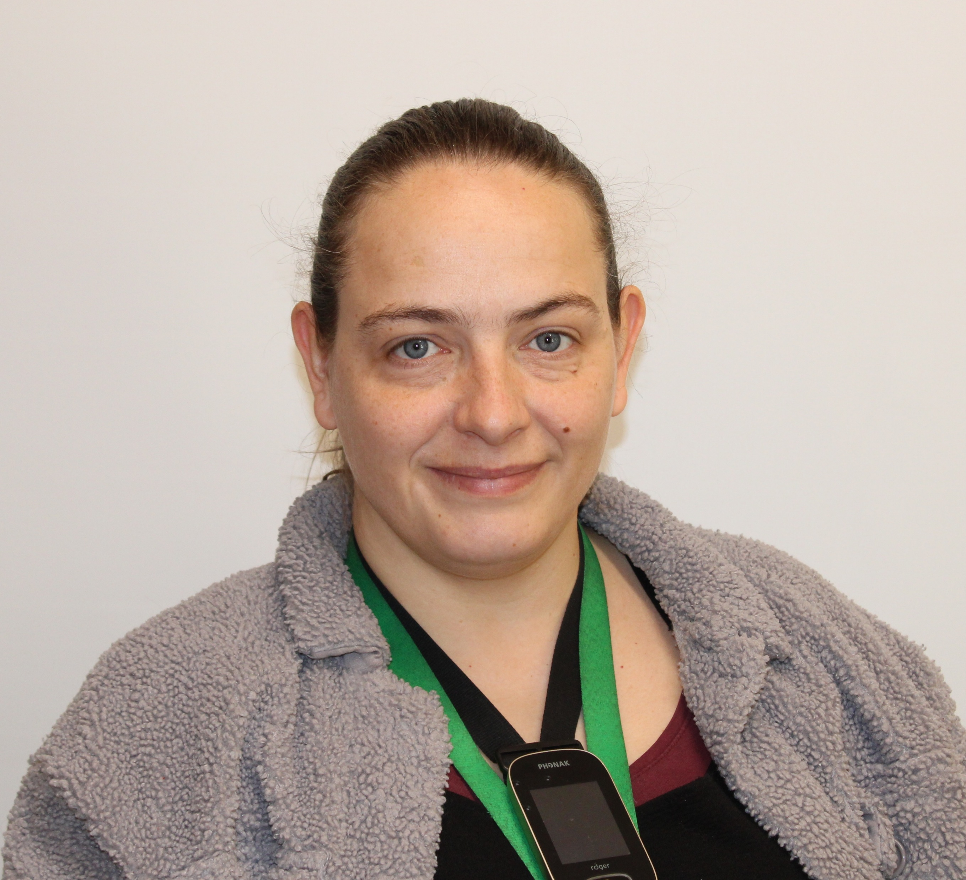
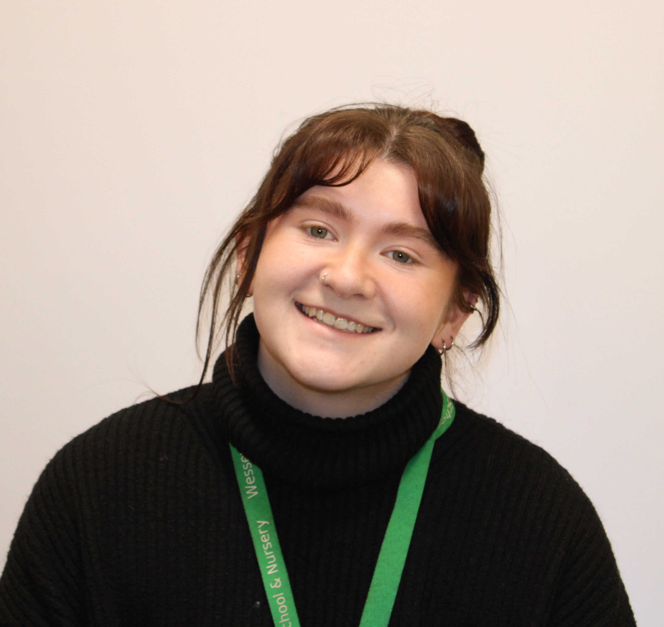
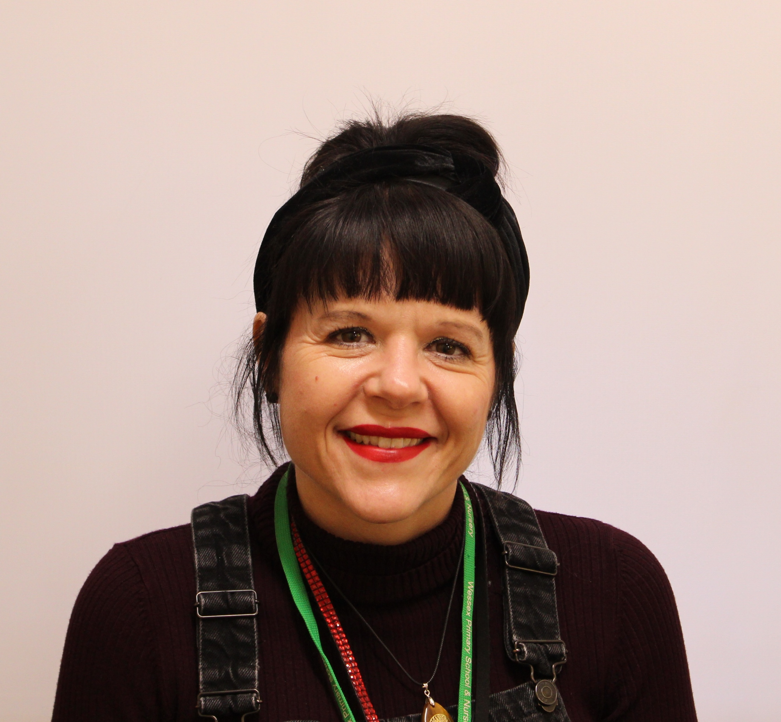



Staff
Wessex
Primary School
Mrs Newman Cherry
Miss Henderson Chestnut
Mrs Lewendon
Mrs Weaver
Mrs Price
Mrs Pope – PPA
Notes:
11 November 2024 until 15 January 2025

Slide 3
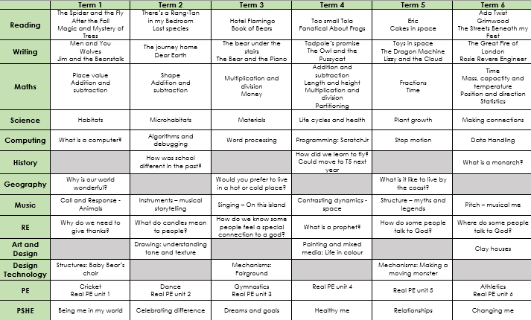
Curriculum Map
Wessex
Primary School
Notes:
11 November 2024 until 15 January 2025

Slide 4
Curriculum Map
Wessex
Primary School
Notes:
11 November 2024 until 15 January 2025

Slide 5
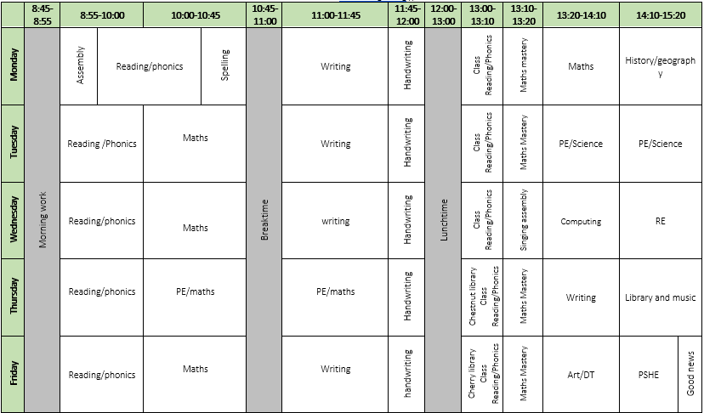
Timetable
Wessex
Primary School
Notes:
11 November 2024 until 15 January 2025

Slide 6
Key Information
Wessex
Primary School
Pencil cases not needed in KS1
Homework – reading, spellings on Seesaw, MyMaths and Numbots/TTRockstars
Reading and library books returned every Thursday
Children who are no longer following phonics scheme will be starting reading comprehension lessons – a letter to follow about how we monitor their reading progress and home reading books
PE days – Tuesday and Thursday
Uniform reminder – PE kit allowed on PE days, normal uniform otherwise
Trips are being thought about and will be arranged
Notes:
11 November 2024 until 15 January 2025

