Slide 1


Wessex
Primary School
Reception
Alder Class & Ash Class
September 2025-2026

Slide 2

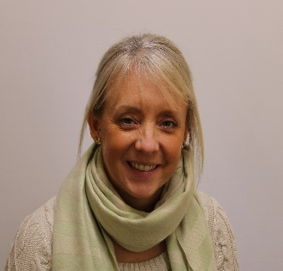
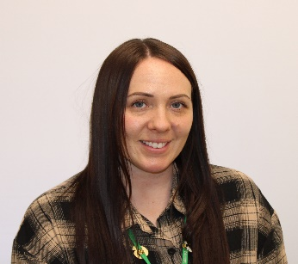


Staff
Wessex
Primary School
Mrs Corbett
Alder
Class teacher
EYFS Phase Lead
Mrs Eves
Ash
Class teacher
Miss Louise
Support staff
Mrs Price
Support staff
Mrs Taylor
Support staff
Notes:
11 November 2024 until 15 January 2025

Slide 3
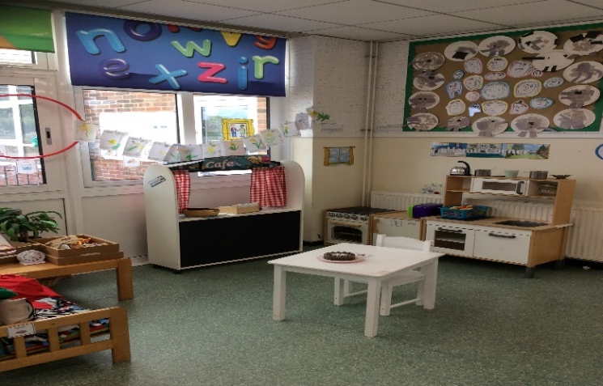
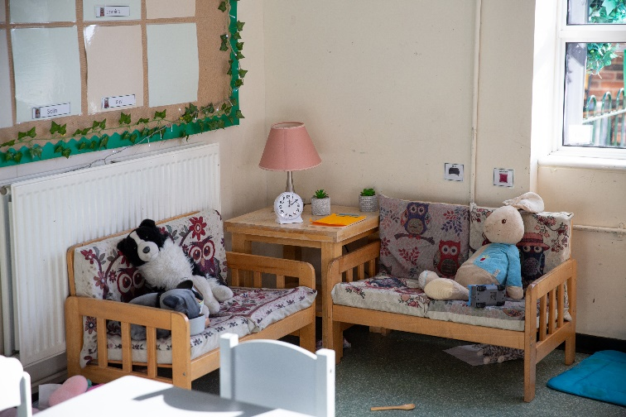
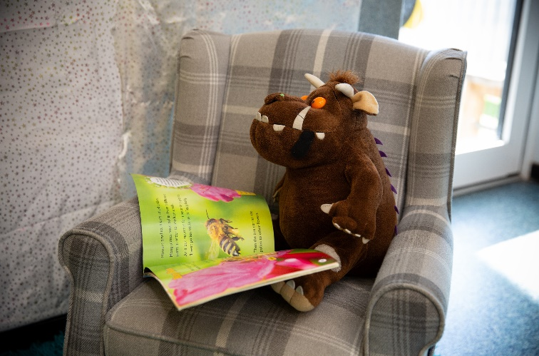
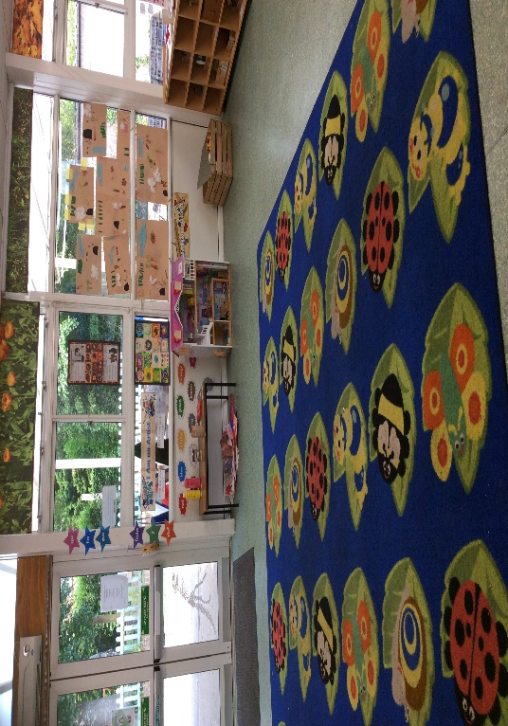
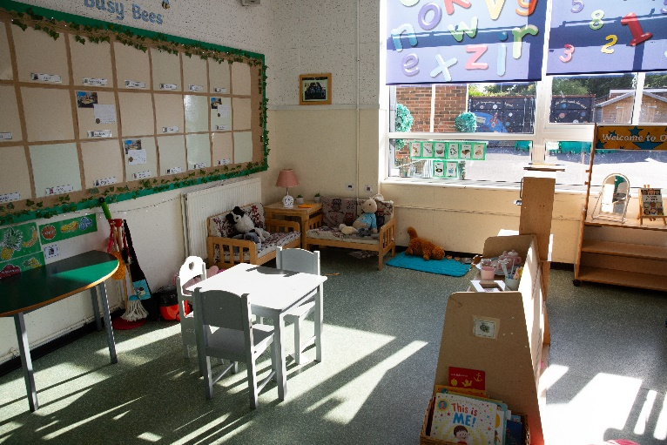
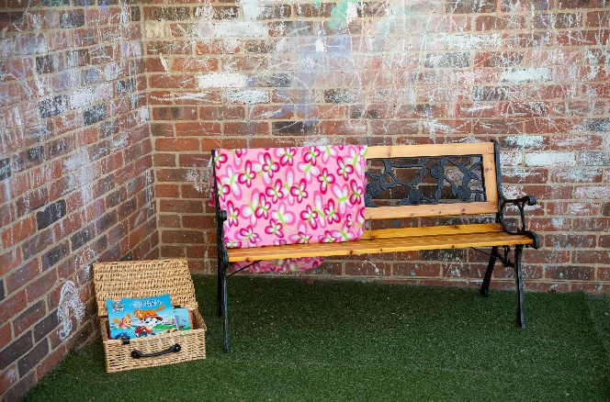
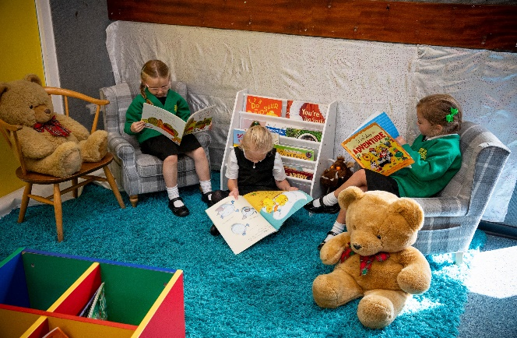
Environment
Wessex
Primary School
Alder classroom
Ash
classroom
Quiet reading areas
Notes:
11 November 2024 until 15 January 2025

Slide 4
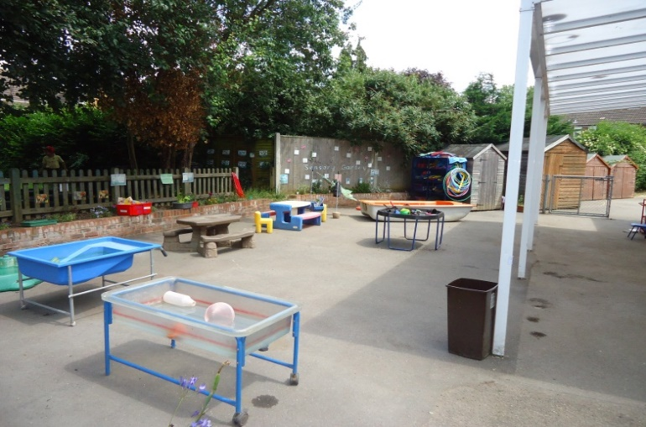
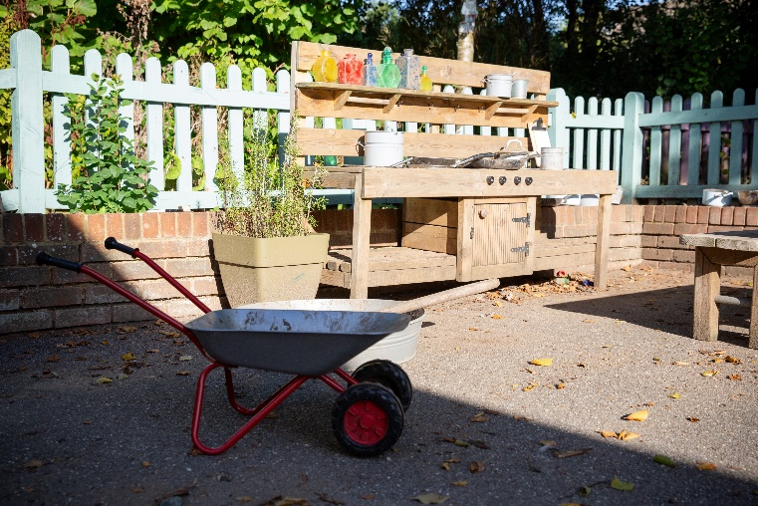
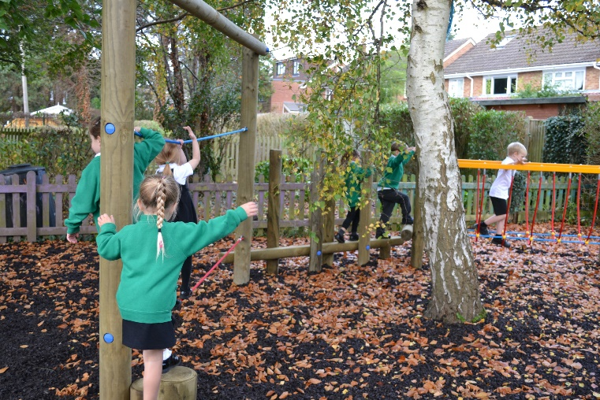
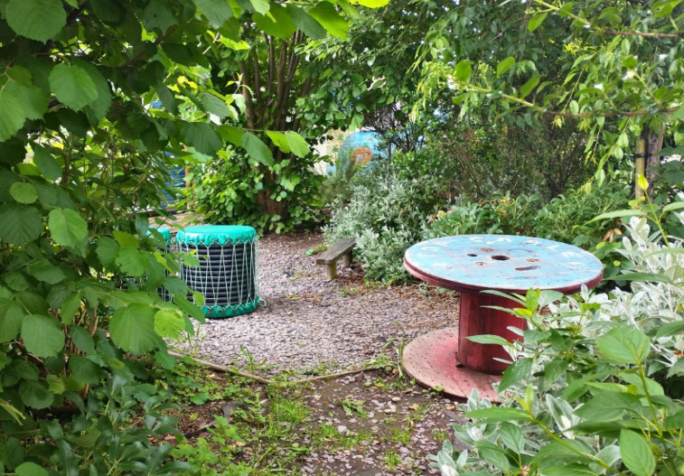
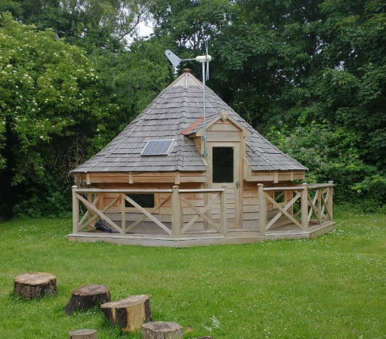
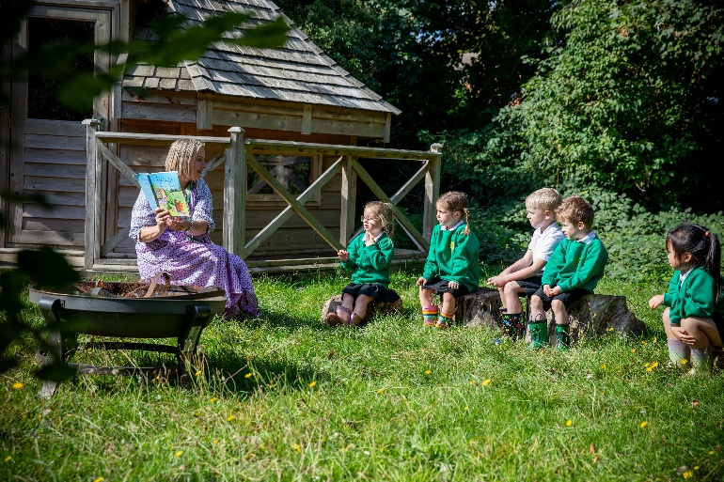
Outdoor Learning
Wessex
Primary School
Garden
Mud Kitchen
Trim Trail
Maze
Treetops classroom
Environmental
area
Notes:
11 November 2024 until 15 January 2025

Slide 5
Curriculum
Wessex
Primary School
The Early Years Foundation Stage is the education of children from birth to the end of Reception. It is based on the principle that children learn best through purposeful play and active learning.
Within the theme of learning and development
there are 7 key areas:
Prime Areas
Personal, Social and Emotional Development
Physical Development
Communication and Language
Specific Areas
Literacy
Maths
Understanding of the World
Expressive Arts and Design
Notes:
11 November 2024 until 15 January 2025

Slide 6
Timetable
Wessex
Primary School
Soft Start/Morning Work
Whole class phonics
Continuous Provision
Phonics and letter formation in small groups
Snack
Maths Mastery
Talk Through Stories
Lunch
Topic
Daily Mile
Continuous Provision/Targeted group work/PE
Vocabulary
Daily singing and story telling
Notes:
11 November 2024 until 15 January 2025

Slide 7
Key Information
Wessex
Primary School
School book bags only with one keyring. Rucksacks are not permitted
Bring in a named water bottle daily. No screw lids
Shoes and trainers with Velcro or buckle fastening support independence
Wellington boots and waterproof wetsuit to leave at school for outdoor learning and messy play
PE kit to be worn on a ….. Your child needs to come to school dressed in their PE kit
Home learning folders will be given out every Friday. They are to be returned to school on a Thursday
Please ensure all of your child’s belongings and clothing is named
Your child should not bring in toys or resources from home
Notes:
11 November 2024 until 15 January 2025

