Slide 1





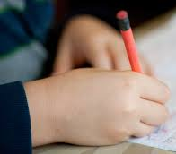

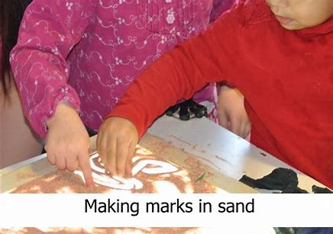


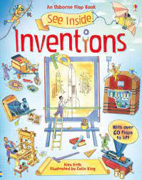

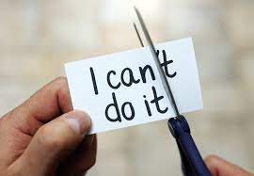
AUTUMN 1 RECEPTION 2025
Expressive Arts and Design
I can draw a self portrait
I can use a pencil to draw pictures
I can use colours in my pictures
I can join in with singing nursery rhymes
I love maths
I can recognise a small number of dots or objects without counting (subitise)
I can join in with songs about numbers
use the words more and fewer to compare groups of up to 10 items.
Communication and language
I can respond to the stories I have listened to
I can talk about my likes and dislikes
I can make my needs known to an adult
Physical Development
Gross Motor: I can navigate my way around the park and climbing equipment safely
Fine Motor: I can mark make using a variety of materials
I love writing
I can write the new phonics sounds I have learned
I can say the rhyme for each letter to help me form letters correctly
Personal, Social and Emotional Development
I know who my teachers and other adults are who can help me at school
I can make new friends and learn their names
Understanding of the World
I can talk about my family
I can observe the natural world, thinking about the changes from summer into autumn
I love reading
I can listen to stories
I can start to understand ‘Fred Talk’ to blend letters to say a word
Characteristics of effective learning
I can follow new routines
I can learn and play cooperatively with my new friends

