Slide 1

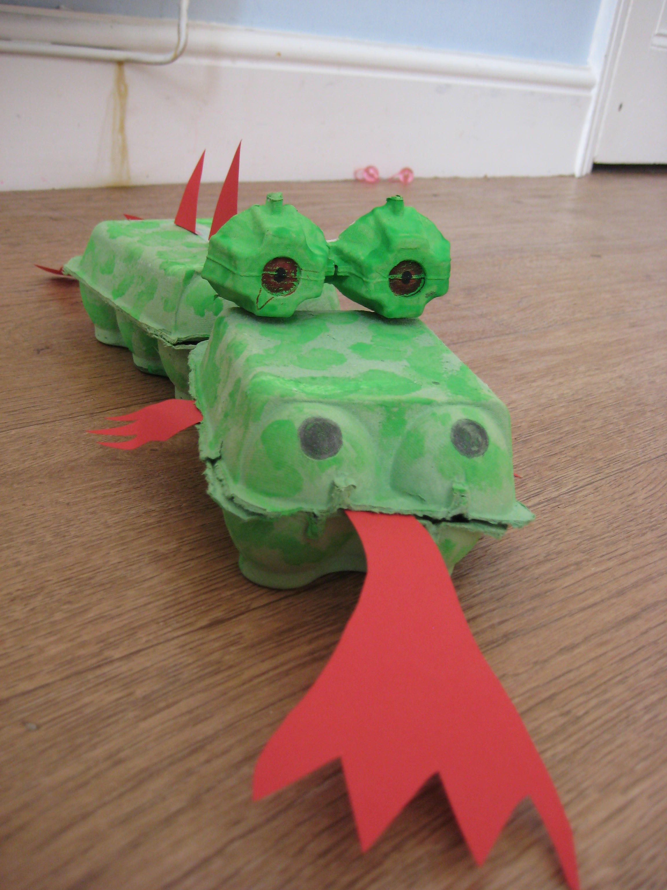

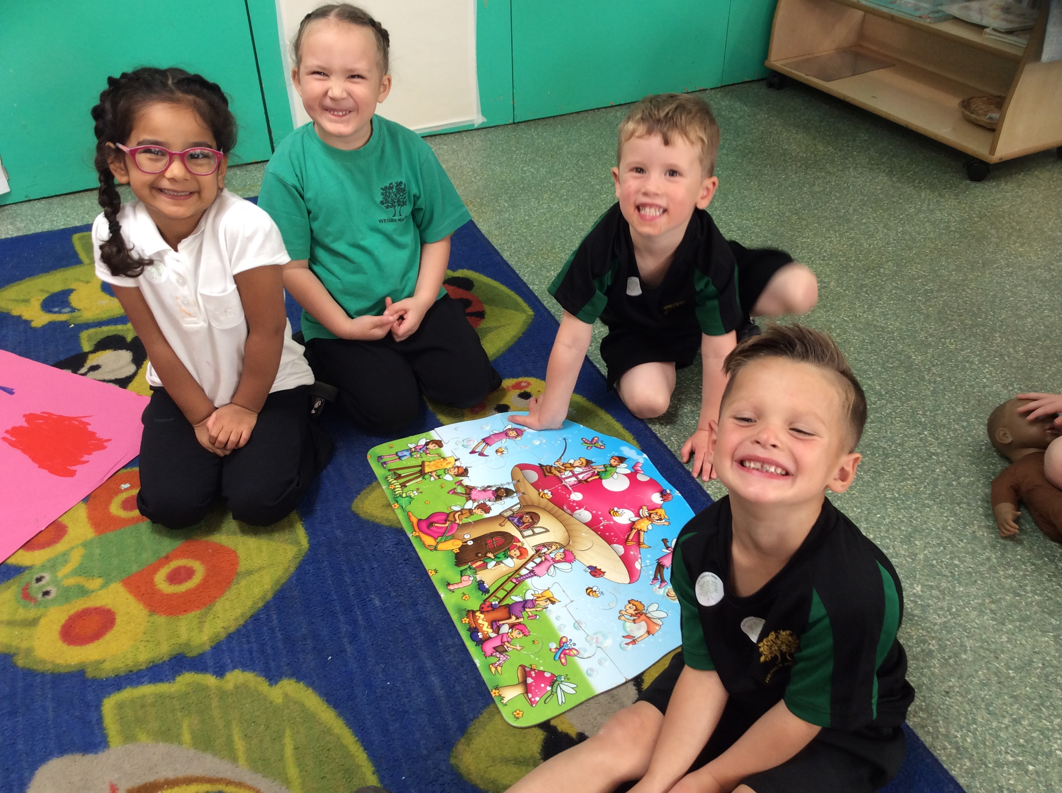
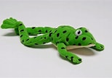
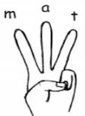
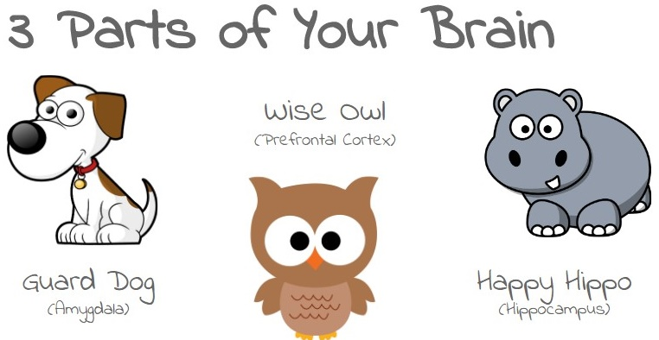

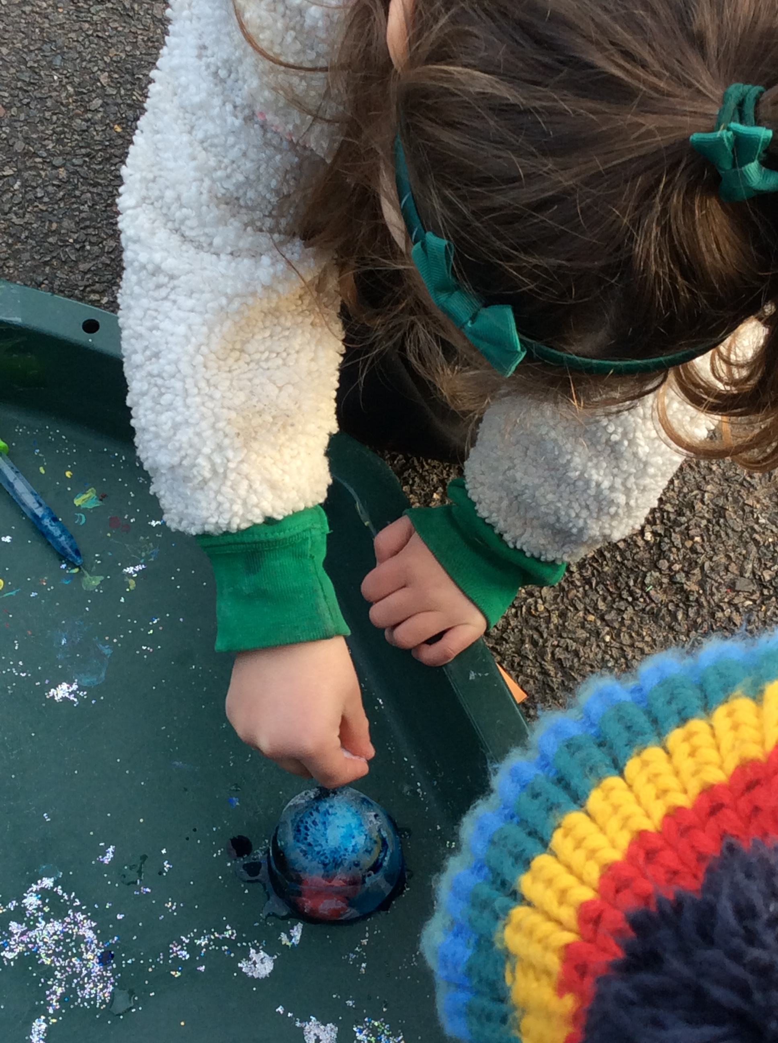

SPRING 1 RECEPTION 2026
Expressive Arts and Design
I can listen and respond to different types of music
I can use a range of equipment to make story props
Maths
Number bonds * part * whole * more * less
* 5 frame * 10 frame * length * height * patterns
Communication and language
I can follow instructions by myself
I can learn new words and use them
I can use talk to support my imaginative play
Physical Development
Gross Motor: I can move, jump and travel in different ways
Fine motor: I can use a pencil using the correct grip and use scissors safely with greater accuracy
Writing
Story scribing
Story acting
Story sequencing
Story maps
Fred fingers to spell
Personal, Social and Emotional Development
I can work collaboratively with my peers
I can start to explain the different parts of my brain
Understanding of the World
I can make observations about the natural world in winter
I can use observations to discover why birds find it difficult to find food in winter and ways to help them
I have more knowledge about owls and birds of prey
Reading
I can use the Phonics I have learned to read words
I can discuss what is happening in a story and say what I think will happen next
I can find out information about birds by reading non - fiction
Characteristics of effective learning
I can…….
find out and explore; play with what I know; be willing to have a go; be involved and concentrate; keep on trying; enjoy achieving what I set out to do.

