Slide 1

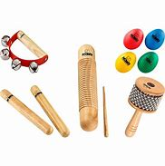
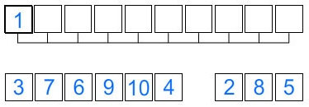
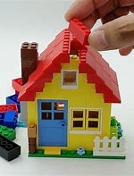
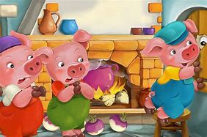

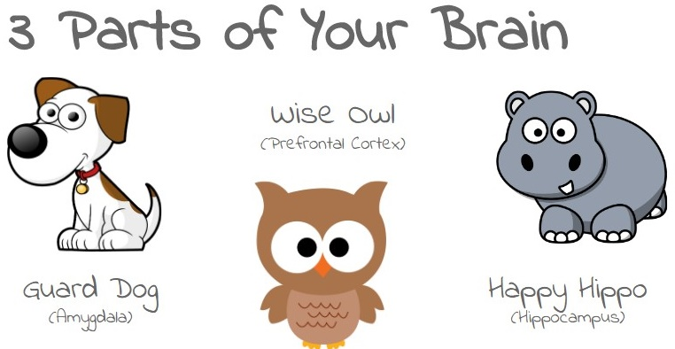

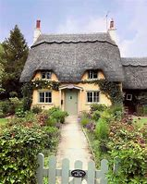

SPRING TERM 2 RECEPTION 2026
Expressive Arts and Design
I can use instruments to help tell a story
I can listen to lyrics and melodies
I can talk about how music makes me feel
I can construct houses using a variety of materials and textures
Maths
I can order numbers and quantities to 10
I know how numbers are made up of other numbers (composition)
I can identify doubles of some numbers
I can recognise, name and find 3D shapes
I can copy, continue and create patterns
Communication and language
I can talk about the different parts of a story: setting, characters, problem and solution
I can use new vocabulary I have learned in different contexts
Physical Development
Gross Motor: I can find different ways of moving, such as high, low, over and under
Fine motor: I can write letters using the correct letter formation and begin to control the size of letters
Writing
I can use Fred Fingers to write words independently
I can write a phrase or sentence with finger spaces
I can spell some tricky words
Personal, Social and Emotional Development
I can use growth mindset to help me make positive decisions and choices
I can consider the needs and feelings of others
Understanding of the World
I can talk about how homes have changed over time
I can compare my home to homes in other countries
Reading
I can sequence a whole story that I know well
I can talk about characters and how they are feeling at different parts in the story
I can read my phonics book using: special friends, Fred Talk and read the word
Characteristics of effective learning
I can concentrate and persevere to complete an activity or task
I can make independent choices

