Slide 1

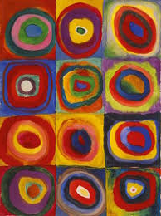



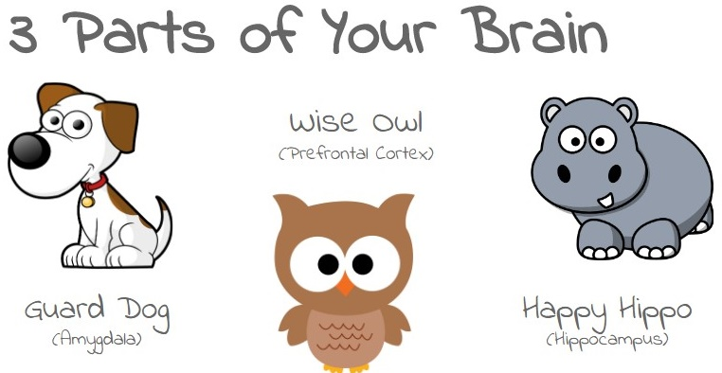
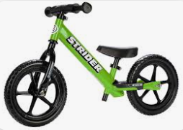
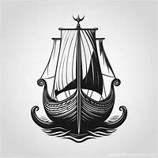
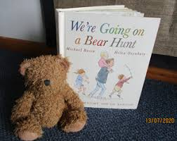
SUMMER 1 RECEPTION 2025
Expressive Arts and Design
I can learn about a famous artist and make a picture using their styles and techniques
I can explore sounds and change the speed (tempo)
I can begin to recognise and understand a musical score
I love maths
I can count forwards and backwards from different numbers
I understand the composition of numbers to 10
I can talk about the different 2D shapes
Communication and language
I can tell you about things I have read in non-fiction texts, such as minibeasts
I can think of some good questions to ask about animals and travel
Physical Development
I can use strength, balance and coordination to ride a balance bike or bike
I can use a pencil with accuracy and have stamina when writing
I love writing
Writing labels
Writing questions
Writing about new things I find out about eg mini beasts
Use Fred fingers to spell
Personal, Social and Emotional Development
I can understand my own feelings and regulate my behaviour to make good choices Show an understanding of their own feelings and those of others, and begin to regulate their behaviour and
Understanding of the World
I can make observations about the natural world in spring
I can talk about different ways to travel, now and in the past e.g. space and water travel
I can make observations of the life cycles of animals
I love reading
I can use phonics to read words, including special friends and tricky words
I can read non-fiction books to find out about mini-beasts and transport
I love choosing books from our library and sharing them with my friends
Characteristics of effective learning
I am motivated and excited to find out new things
I explore new things and want to share my learning with friends and adults

