Slide 1


Welcome to Wessex
Wessex
Primary School
Reception Curriculum Meeting
September 2025

Slide 2
Welcome
Wessex
Primary School
Monitoring
The Early Years Curriculum
Reading and Writing
Talk Through Stories
Maths Mastery
Continuous Provision
Timetable
Behaviours for Learning
Autumn Term 2025
Notes:
11 November 2024 until 15 January 2025

Slide 3
Monitoring
Wessex
Primary School
Baseline assessments are carried out to determine your child’s starting point at the beginning of Reception.
Each of the areas has its own set of Early Learning Goals which determine what most children are expected to achieve by the end of Reception.
We discover how best to support your child in their unique learning journey (formative assessment ).
Activities planned ensure each child can build on their previous learning (summative assessment).
At the end of the year, an EYFS Profile is completed for each child. This provides parents and teachers
with a record of each child’s knowledge, understanding and their readiness for Year 1.
Notes:
11 November 2024 until 15 January 2025

Slide 4
Curriculum
Wessex
Primary School
The Early Years Foundation Stage is the education of children from birth to the end of Reception.
It is based on the principle that children learn best through purposeful play and active learning.
Children learn and develop in enabling environments.
Children learn to be independent through building positive relationships with adults and peers.
Every child is unique and learns and develops in different ways and at different rates
- bespoke curriculum for all.
Notes:
11 November 2024 until 15 January 2025

Slide 5
Curriculum
Wessex
Primary School
Within the theme of learning and development there are 7 key areas:
Prime Areas
Personal, Social and Emotional Development
Physical Development
Communication and Language
Specific Areas
Literacy
Mathematics
Understanding the World
Expressive Arts and Design
Notes:
11 November 2024 until 15 January 2025

Slide 6
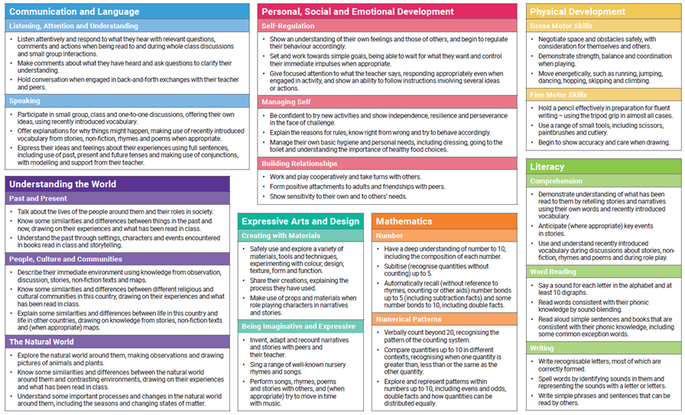
Curriculum
Wessex
Primary School
Notes:
11 November 2024 until 15 January 2025

Slide 7
Reading & Writing
Wessex
Primary School
Listening Skills
Language rich environment
Retell stories, nursery rhymes
Provide opportunities to read : baskets in the indoor and outdoor environment including quiet areas
Read Write Inc RWI
Formal teaching of phonemes (sounds)
Daily phonic lesson followed by small group activity
Daily review of learning
Apply phonics knowledge in reading and writing (Fred Talk and Fred Fingers)
Reading support and library books sent home
Notes:
11 November 2024 until 15 January 2025

Slide 8

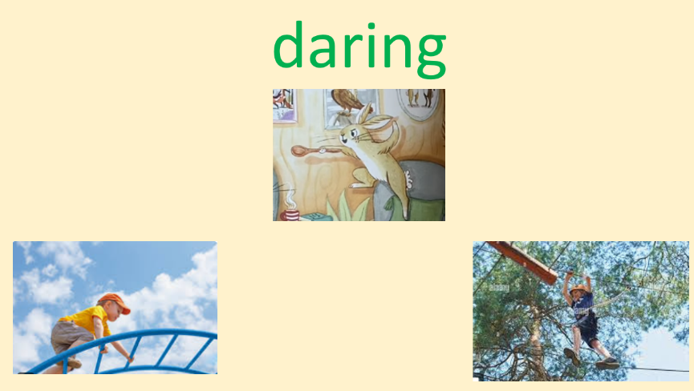

Talk Through Stories
Wessex
Primary School
Develop oracy and vocabulary skills
Develop children’s understanding of words through context
Gets children talking including use of talk partners
Talk about events before reasoning or emotional response
Children link vocabulary to own experience
Children use new vocabulary in context independently
Windows and Mirrors
Books on own experiences and the world around them
Characters and protagonists from diverse backgrounds
Normalise differences, develop empathy and educating children for the world they are living in
Notes:
11 November 2024 until 15 January 2025

Slide 9
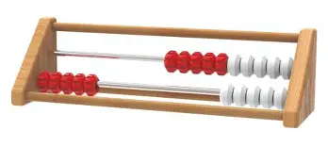
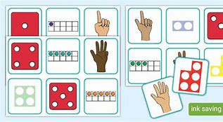
Maths Mastery
Wessex
Primary School
Detailed sequence of content to support progression
Develop a deep understanding of the key ideas that are needed to underpin future learning
Precise mathematical language enables all pupils to communicate their reasoning and thinking effectively
Misconceptions are identified quickly and gaps in understanding are addressed systematically to prevent them falling behind
Children are confident making links between concepts
Notes:
11 November 2024 until 15 January 2025

Slide 10
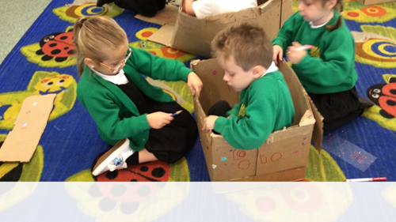
Continuous Provision
Wessex
Primary School
Communication and language Independence
Listening skills Perseverance
Sharing & Turn taking Understanding of the world
Problem solving Cross Curricular
Team- work
Imagination
FUN & ENGAGED
whilst
LEARNING
Notes:
11 November 2024 until 15 January 2025

Slide 11
Timetable
Wessex
Primary School
Soft Start/Morning Work
Whole class phonics
Phonics and letter formation in small groups
Continuous Provision
Snack
Maths Mastery
Talk Through Stories
Lunch
Topic
Daily Mile
Continuous Provision/Targeted group work/PE
Vocabulary
Daily singing and story telling
Notes:
11 November 2024 until 15 January 2025

Slide 12



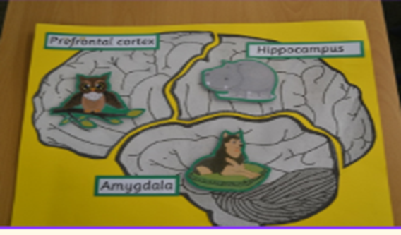
Behaviours for Learning
Wessex
Primary School
Personal , Social, Emotional Development is a key focus in Reception
Wessex Character Curriculum
Wessex Values
Wessex value stickers (T2)
Behaviours for learning
Growth Mindset
Good News certificates
Golden Head Teacher sticker from Mr Beavan
Notes:
11 November 2024 until 15 January 2025

Slide 13
Home Learning
Wessex
Primary School
Phonics speed sound cards
Fine motor skills and letter formation activity
Reading book and library book
Activities to enhance learning
Folders sent home on a Friday and returned on a Thursday
Notes:
11 November 2024 until 15 January 2025

Slide 14
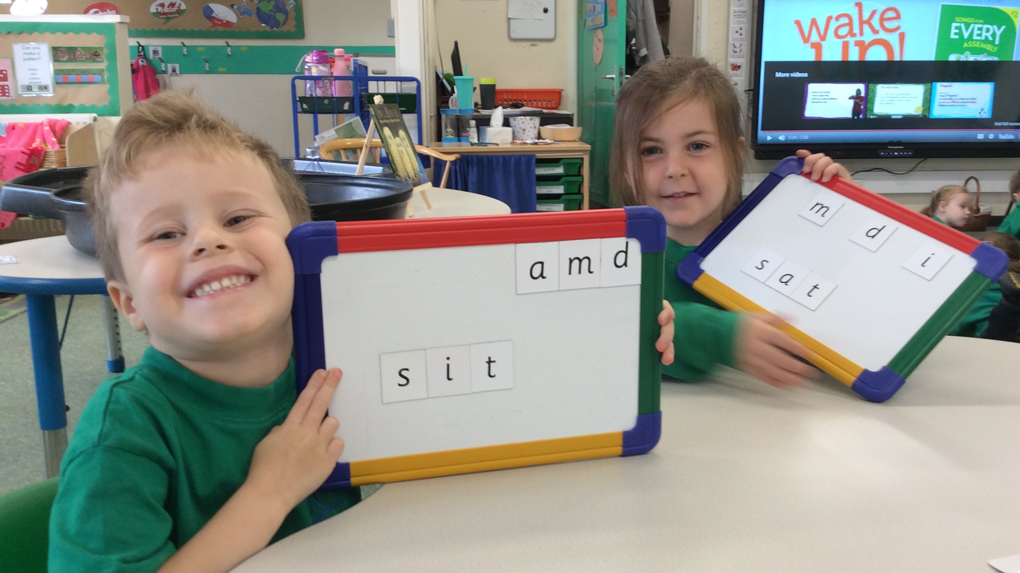
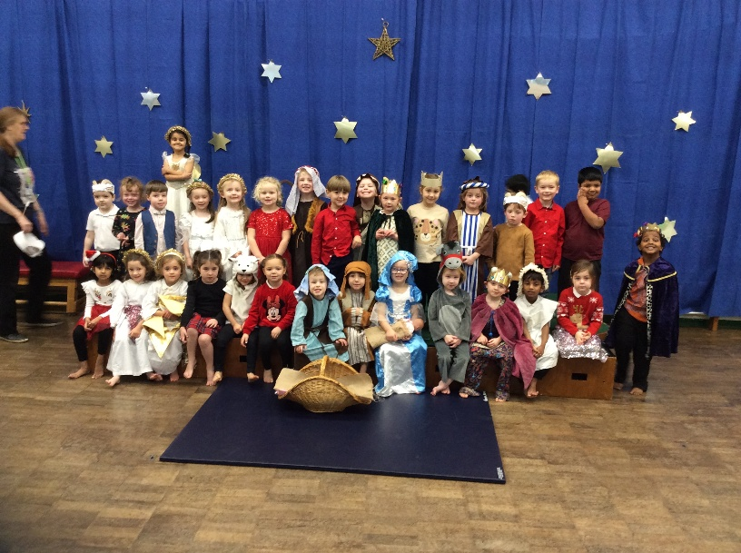
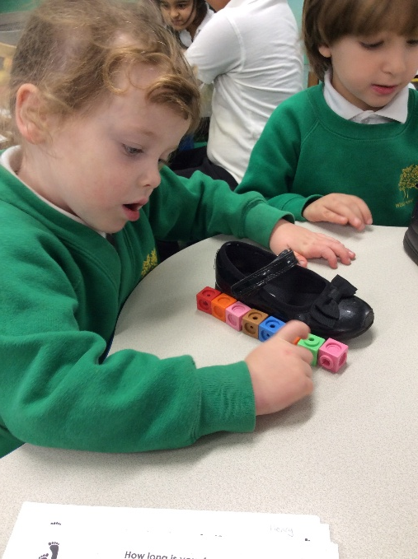
Events
Wessex
Primary School
Thursday 9th October:
Phonics information session and stay and play
8:45 – 9:45
Wednesday 24th September:
Stay and Play
8:45 – 9:25
Wednesday 10th December:
Nativity
9:15 – 9:45
Wednesday 16th December:
Christmas Play and Stay
8:45 – 9:30
Notes:
11 November 2024 until 15 January 2025

Slide 15
Wessex
Primary School
Thank you

